Slide 1
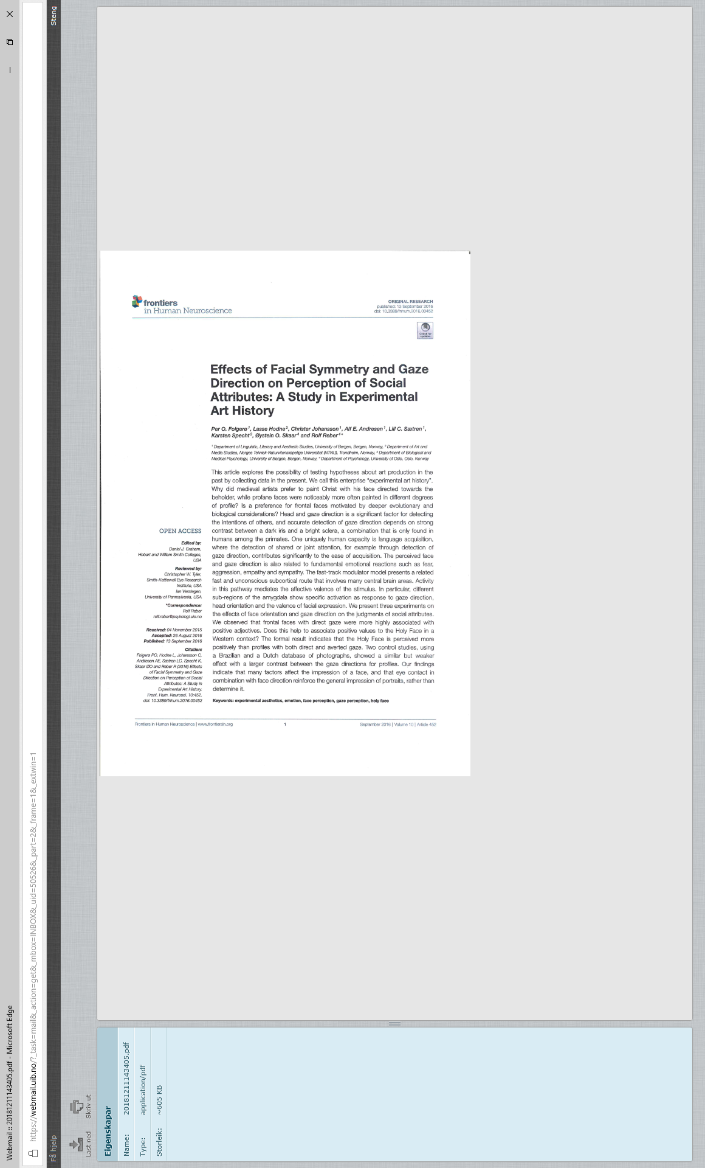
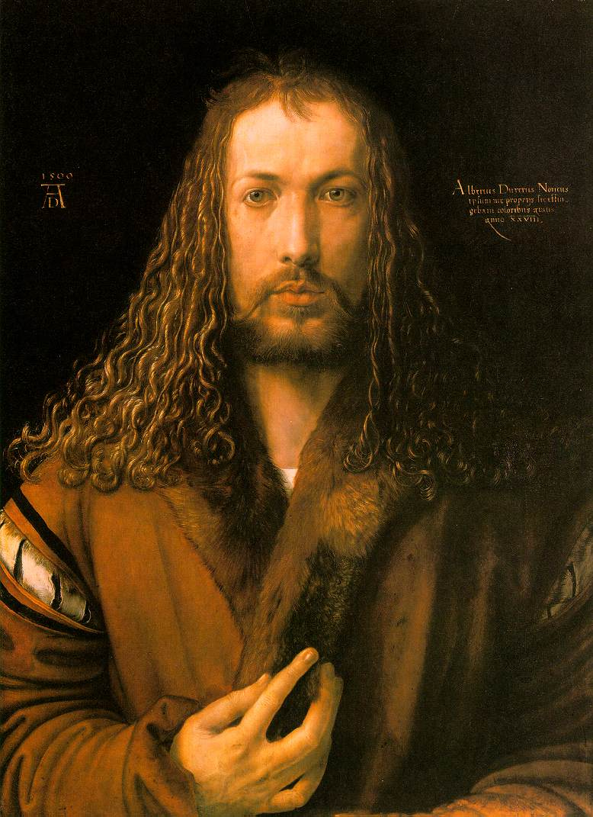

Slide 2
This project started with a statistical analysis of portraits in Europe painted during the 15th and the 16th centuries. Almost no frontal, i.e. (close to) symmetrical portraits of secular persons from this period are conserved. On the other hand, the frontal is the normal posture when it comes to the so called ´holy face’, i.e., Christ painted in his divinity.
Question: Is a frontal face in the art material associated with divinity based solely on artistic and theologiclal convention? Or are there deeper biological and evolutionary reasons?
We wanted to study this by a survey on whether particular adjectives can be associated with each of the two types of portraits (the list of adjectives is presented below).

Slide 3
The following slides are from the Abstract of the article

Slide 4
This article explores the possibility of testing hypotheses about art production in the past by collecting data in the present. We call this enterprise “experimental art history”.

Slide 5
This article explores the possibility of testing hypotheses about art production in the past by collecting data in the present. We call this enterprise “experimental art history”. Why did medieval artists prefer to paint Christ with his face directed towards the beholder, while profane faces were noticeably more often painted in different degrees of profile?

Slide 6
This article explores the possibility of testing hypotheses about art production in the past by collecting data in the present. We call this enterprise “experimental art history”. Why did medieval artists prefer to paint Christ with his face directed towards the beholder, while profane faces were noticeably more often painted in different degrees of profile? Is a preference for frontal faces motivated by deeper evolutionary and biological considerations?

Slide 7
This article explores the possibility of testing hypotheses about art production in the past by collecting data in the present. We call this enterprise “experimental art history”. Why did medieval artists prefer to paint Christ with his face directed towards the beholder, while profane faces were noticeably more often painted in different degrees of profile? Is a preference for frontal faces motivated by deeper evolutionary and biological considerations? (Mind that) head and gaze direction is a significant factor for detecting the intentions of others, and accurate detection of gaze direction depends on strong contrast between a dark iris and a bright sclera, a combination that is only found in humans among the primates.

Slide 8
The perceived face and gaze direction is also related to fundamental emotional reactions such as fear, aggression, empathy and sympathy. (…) In particular, different sub-regions of the amygdala show specific activation as response to gaze direction, head orientation and the valence of facial expression.
We present three experiments on the effects of face orientation and gaze direction on the judgments of social attributes. We observed that frontal faces with direct gaze were more highly associated with positive adjectives.
The formal result indicates that the Holy Face is perceived more positively than profiles with both direct and averted gaze.

Slide 9
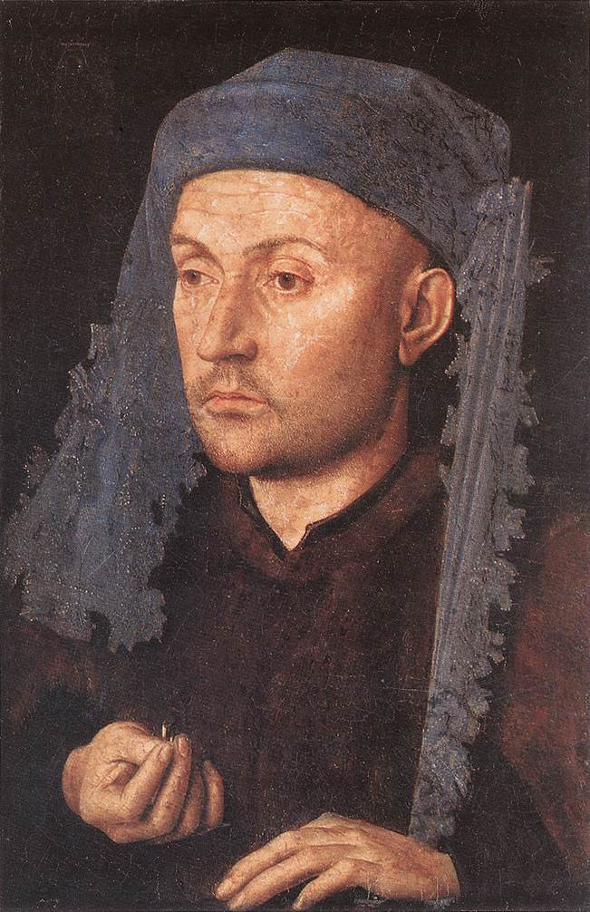
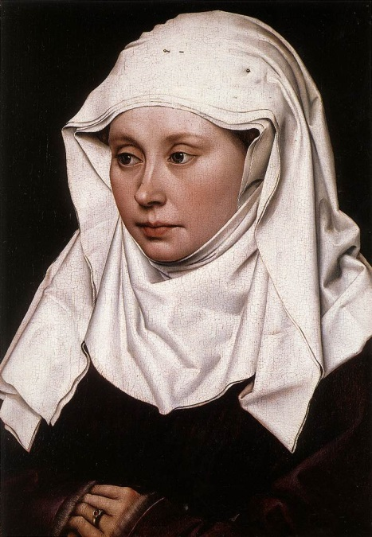
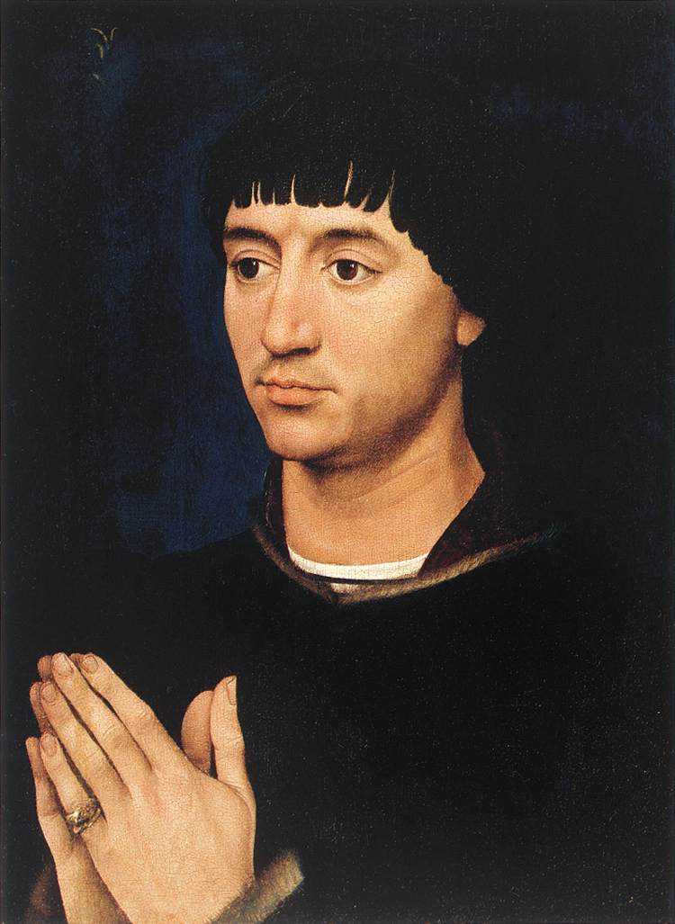
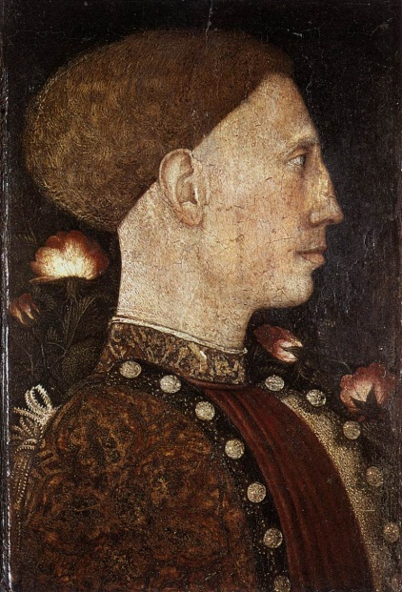
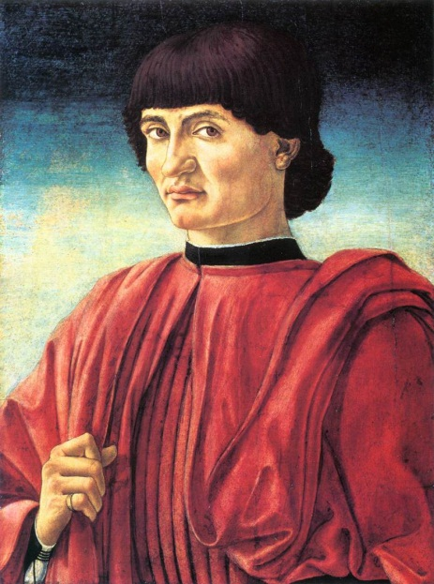
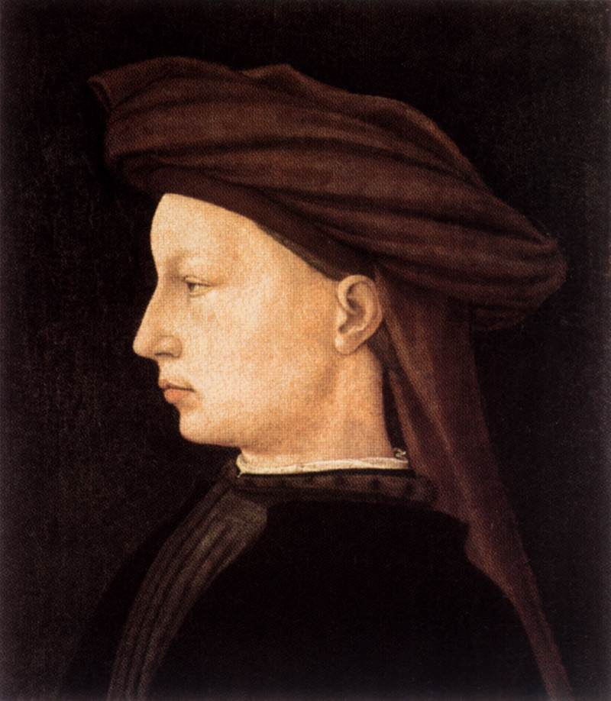
Secular portraits, 15th c. By Van Eyck, The master of Flémalle, R. v. d. Weyden, Pisanello, Castagno, Masaccio

Slide 10
The Holy face, 15th c.

Slide 11
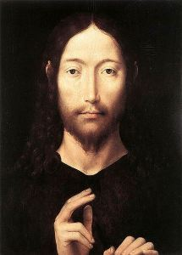
Hans Memling, late 15th c.

Slide 12
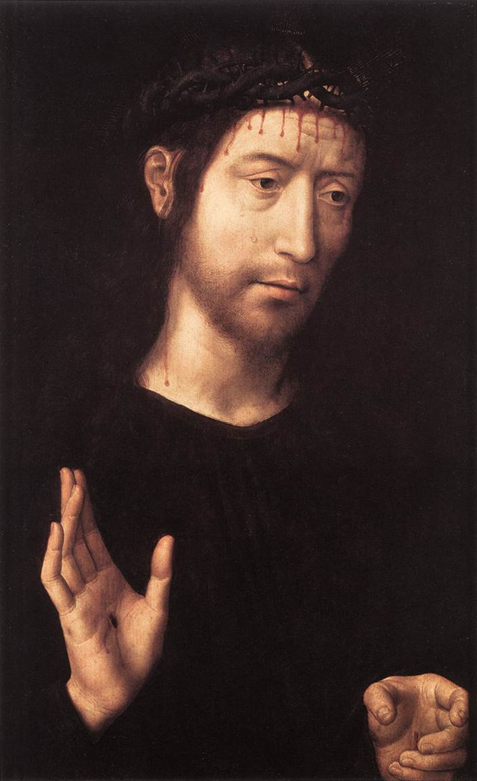
Hans Memling, late 15th c.

Slide 13
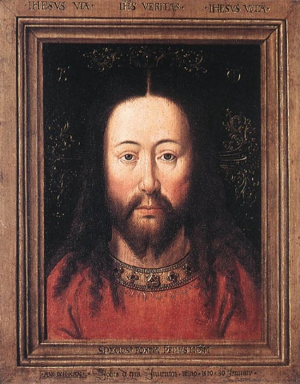

Slide 14
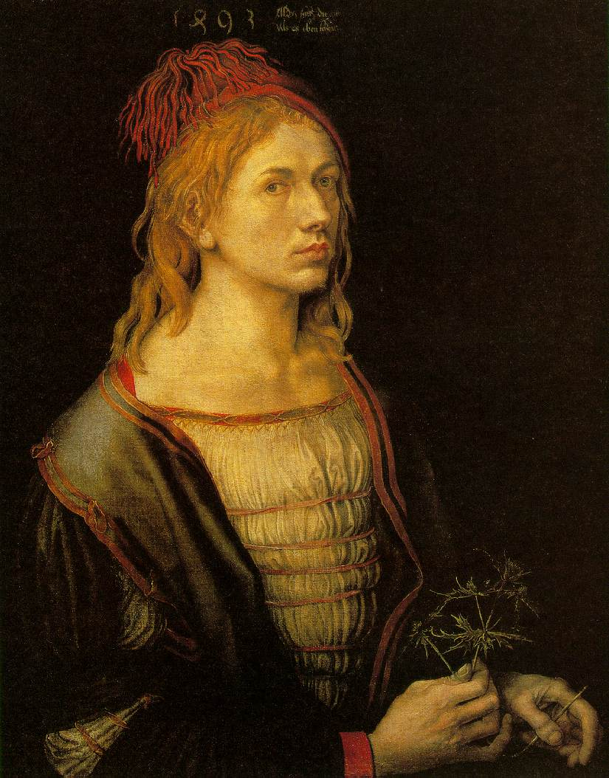

Slide 15
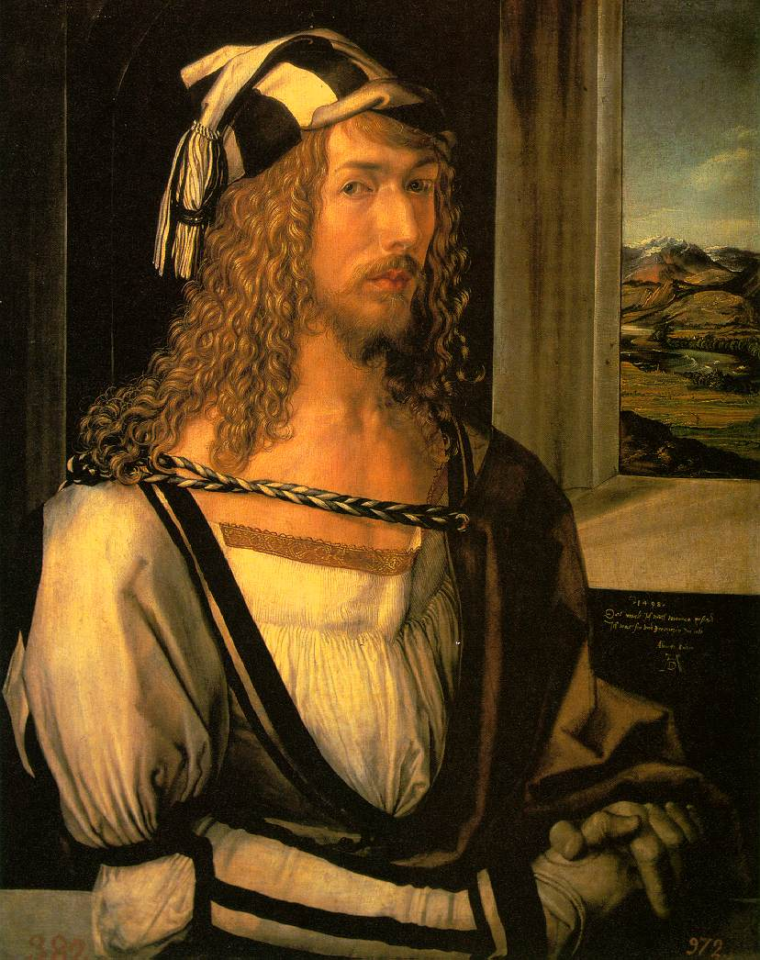
Notes:
1498

Slide 17
On the next slides there are portraits deriving from statues of generals in Garibaldi’s army, all located at Gianiccolo, Rome. These were used in our pilot study.
Eyes manipulated/unmanipulated.

Slide 18
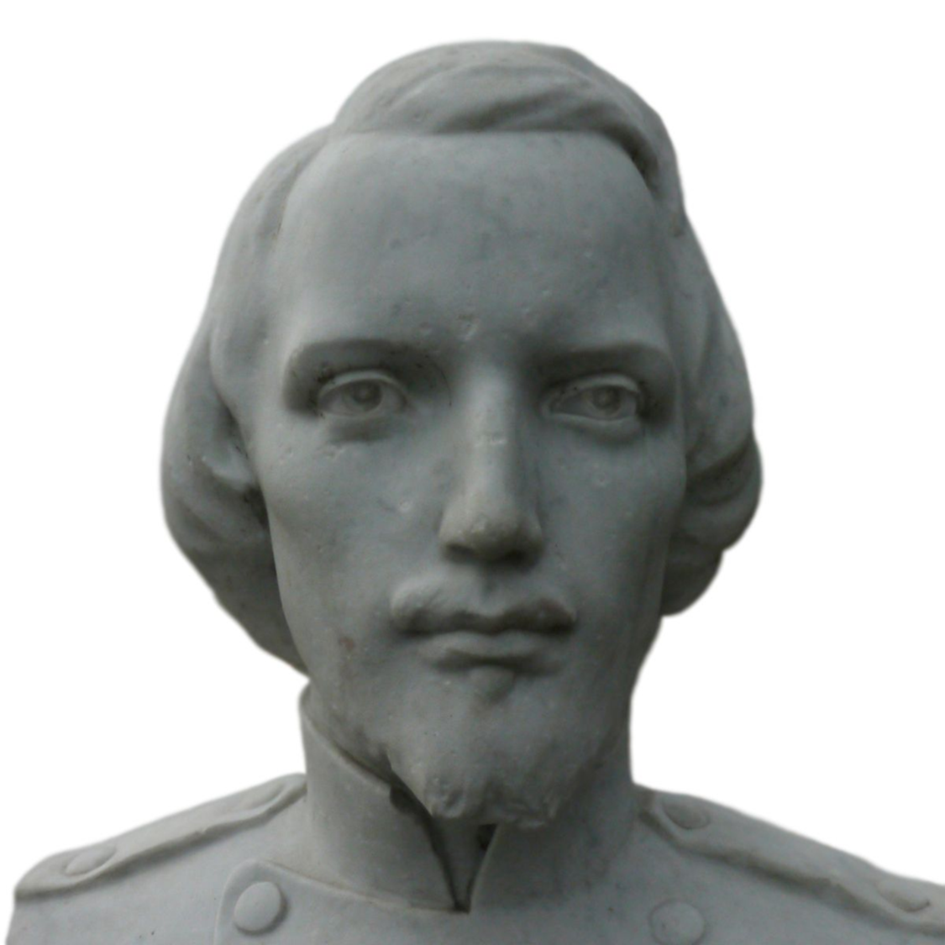

Slide 19
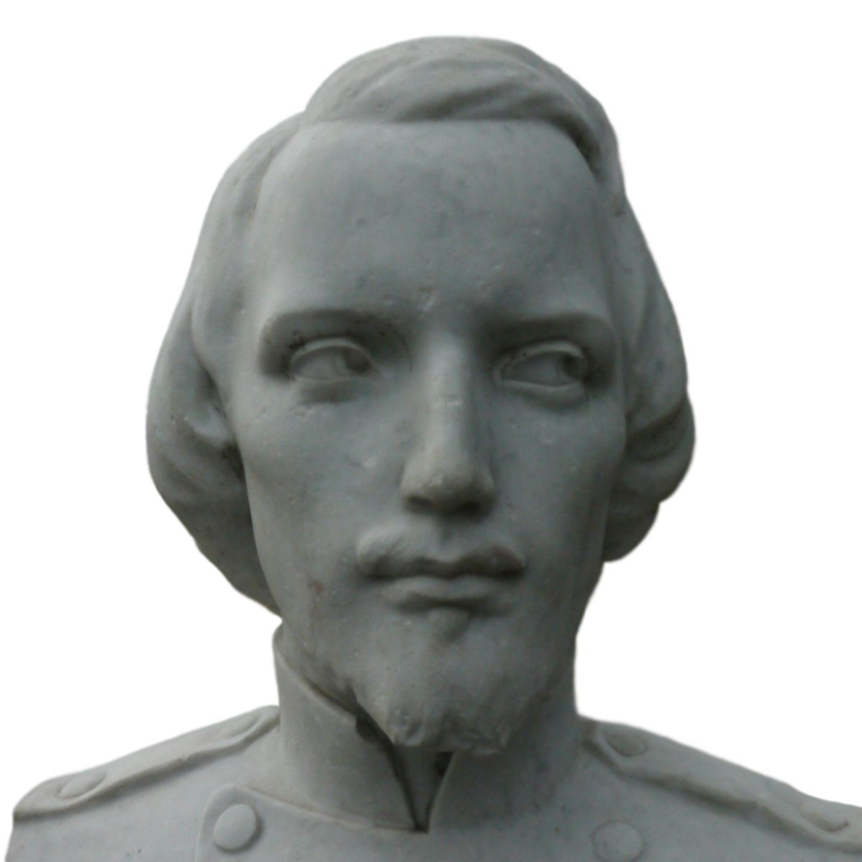

Slide 21
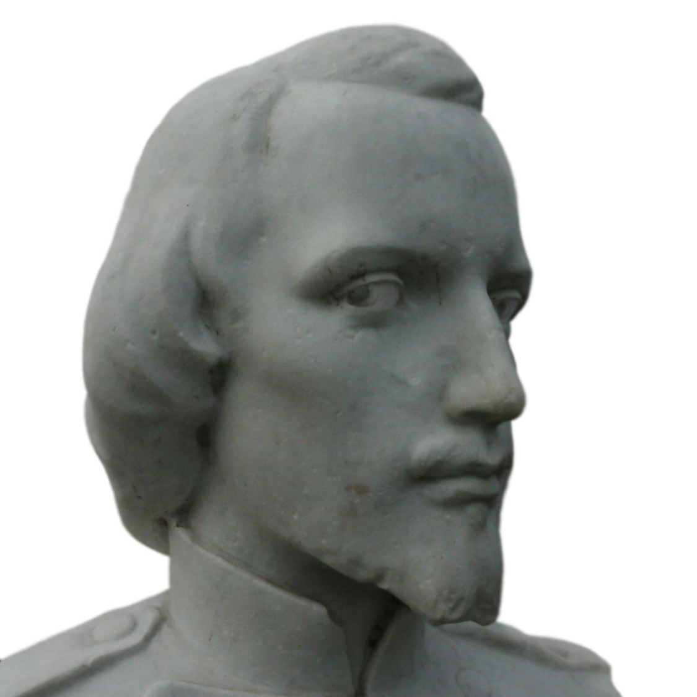

Slide 22
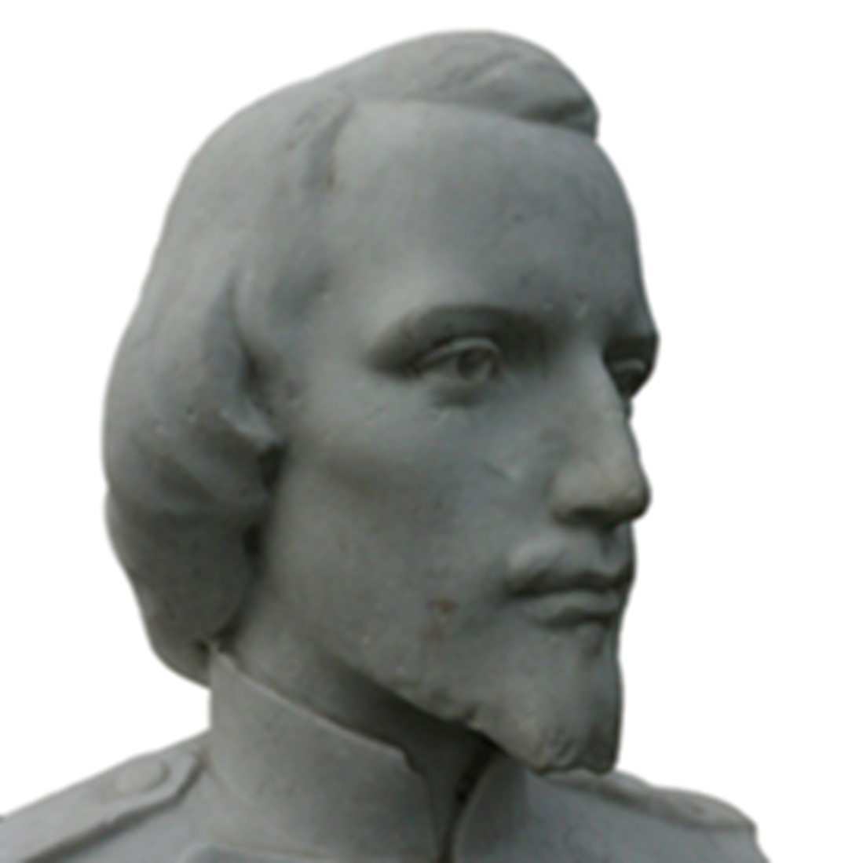

Slide 23
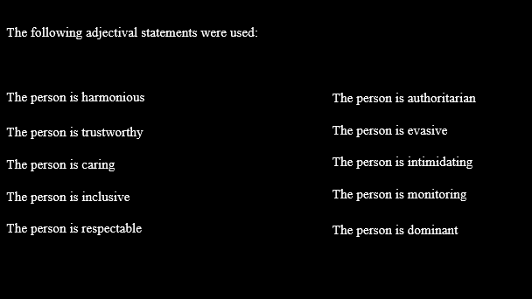

Slide 24
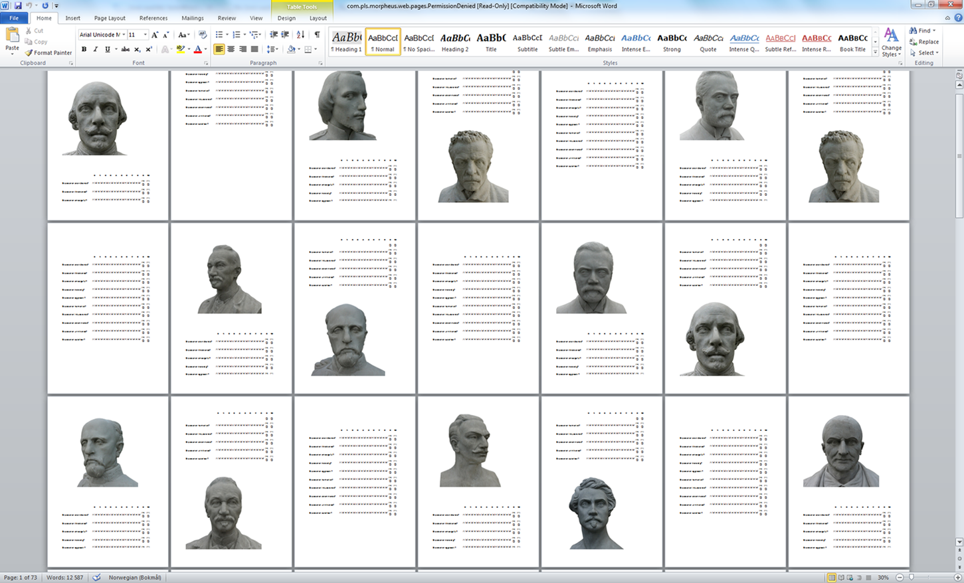
Questioanary: SurveyXact
Notes:
Questioanary: SurveyXact

Slide 25

The en face gazing at you is more authoritarian, but also more credible, more caring, more trustworthy, more harmonic, and more including.

Slide 26
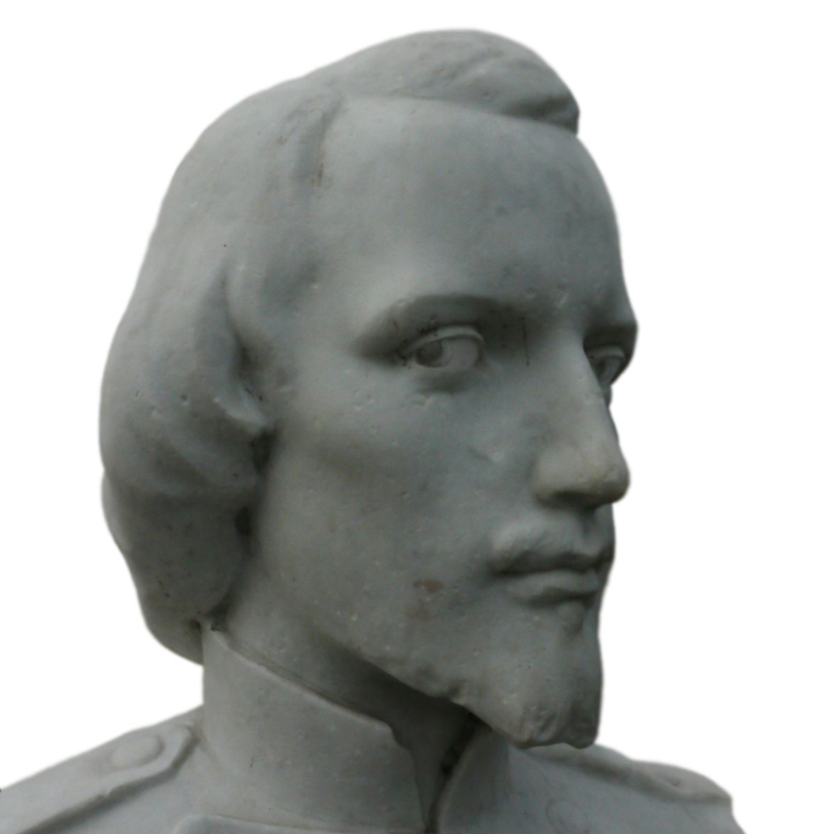
The profile looking at you is the more scaring and monitoring, reversed when looking away.

Slide 28




Frontal Direct (FD)
Frontal Averted (FA)
Profile Direct (PD)
Profile Averted (PA)

Slide 29
The following face derives from the Dutch Radboud Faces Database (RaFD)

Slide 30
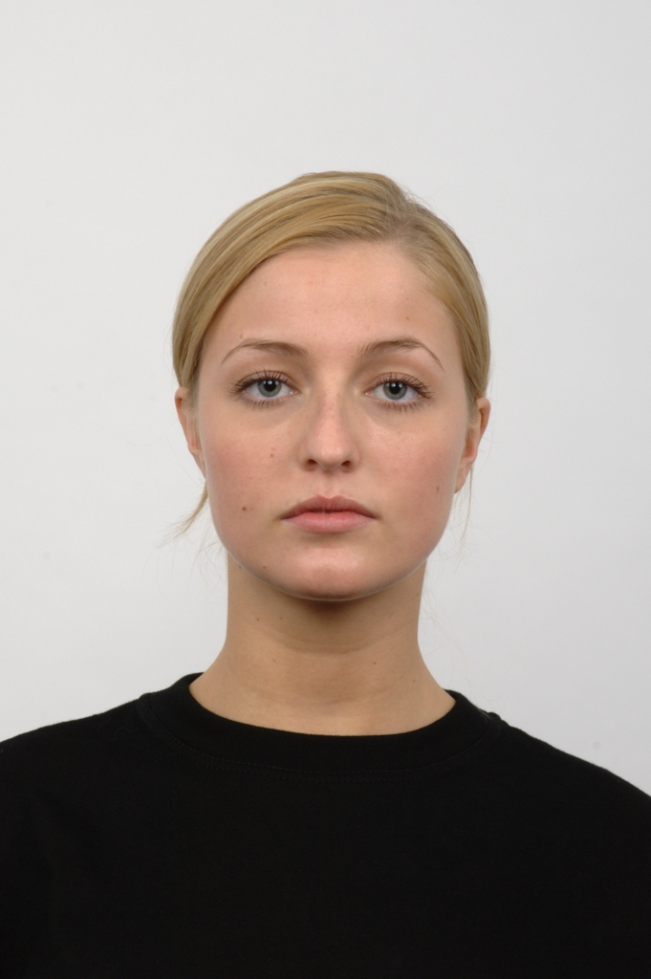
Frontal direct

Slide 31
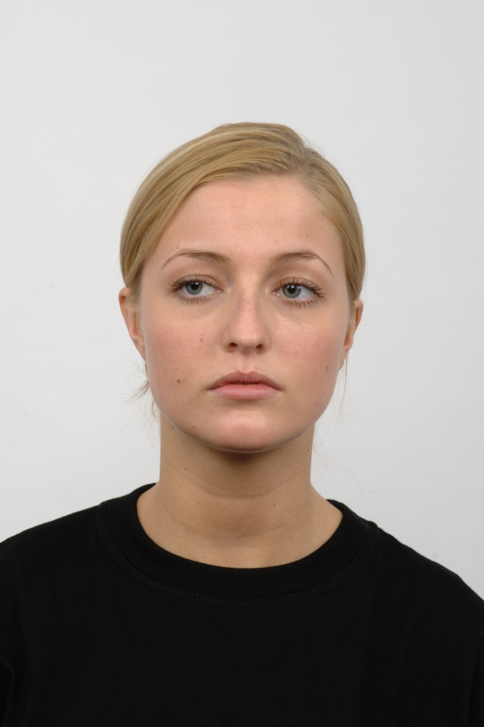
Frontal averted

Slide 32
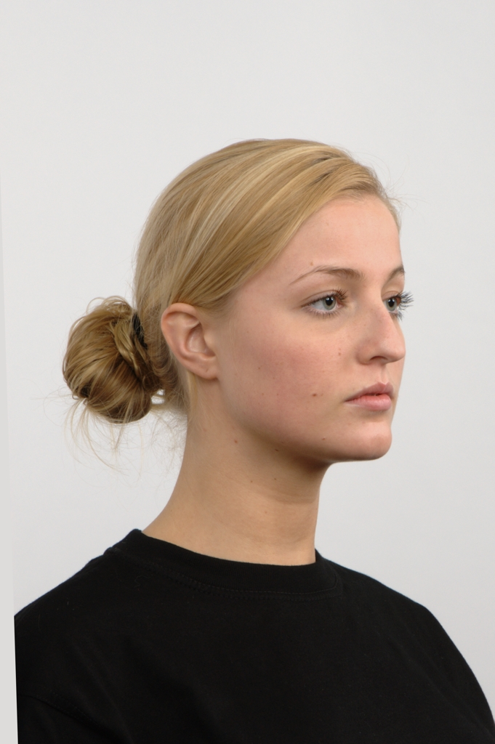
Profile averted

Slide 33
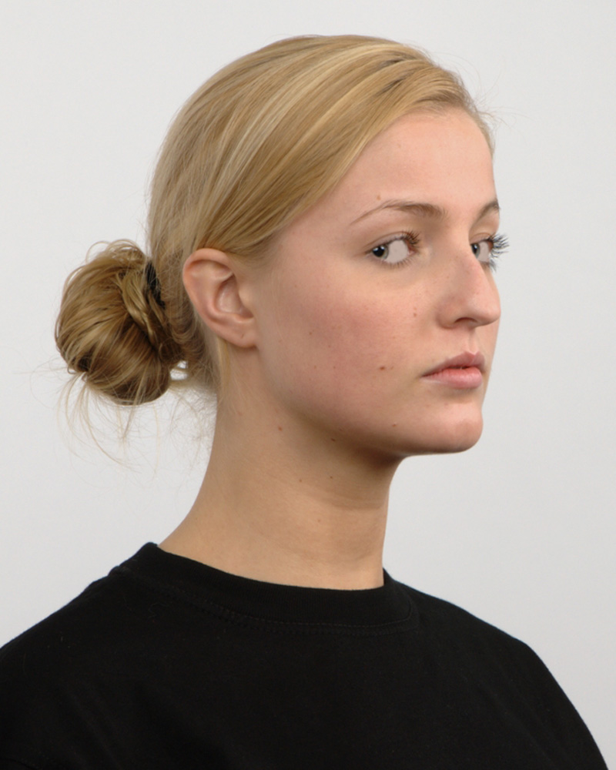
Profile direct

Slide 34
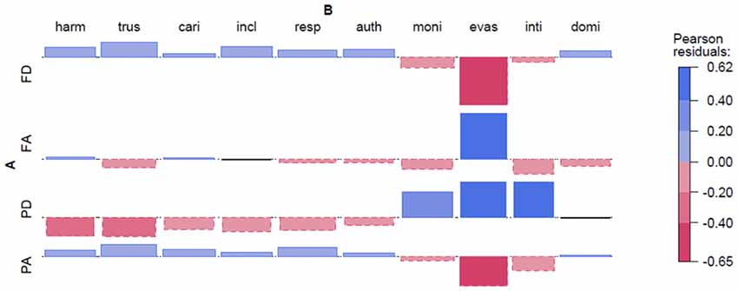
Deviations from statistical independence of rows and columns in a matrix.
For the sake of simplicity, we will here solely look at the results from RaFD on Dutch faces.
Each image category has an indicated line that marks statistical independence, and deviance is marked by boxes that could either be higher (blue above the line) or lower (red below the line) than expected from statistical independence.
Colour is coded by the so called Pearson Residuals (Meyer et al., 2003).
Figure 2. Dutch Radboud Faces Database (RaFD).

Slide 35




Figure 2. Dutch Radboud Faces Database (RaFD). Abbreviations: FD=Frontal Direct, FA=F. Averted, PD=Profile Direct, PA=P. Averted; harm=harmonious, trus=trustworthy, cari=caring, incl=inclusive, resp=respectable, auth=authoritarian, moni=monitoring, evas=evasive, inti=intimidating, domi=dominant.

Slide 36
Experiment 1: Dutch Photographs (cf. Figure 2), last slide.
Experiment 1: Dutch Photographs (cf. Figure 2), last slide. We can see that Frontal Direct and Profile Direct differ in scores for positive and negative adjectives.

Slide 37
Experiment 1: Dutch Photographs (cf. Figure 2), last slide.
Experiment 1: Dutch Photographs (cf. Figure 2), last slide. We can see that Frontal Direct and Profile Direct differ in scores for positive and negative adjectives.
Likewise, Profile Direct and Profile Averted are close mirror images of each other.
This shows that both face direction and gaze direction plays a role for the assignment of personality traits to the photographs.

Slide 38
Experiment 1: Dutch Photographs (cf. Figure 2), last slide.
Experiment 1: Dutch Photographs (cf. Figure 2), last slide. We can see that Frontal Direct and Profile Direct differ in scores for positive and negative adjectives.
Likewise, Profile Direct and Profile Averted are close mirror images of each other.
This shows that both face direction and gaze direction plays a role for the assignment of personality traits to the photographs.
However, we can also note that the largest effect stems from the adjective evasive, which is the adjective that may be the easiest to associate with an averted gaze.

Slide 39
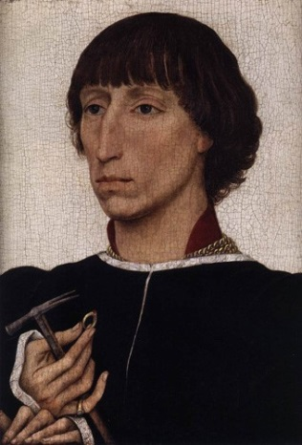
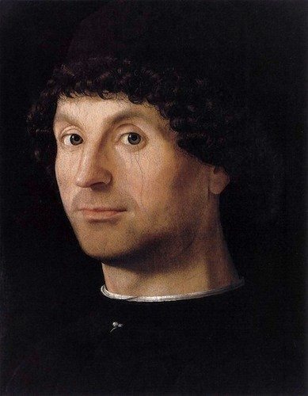
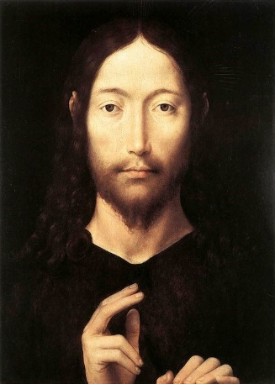
Experiment 3: Holy Faces and secular portraits (1). Figure 4, next slides
Averted/Indirect Direct
Holy

Slide 40
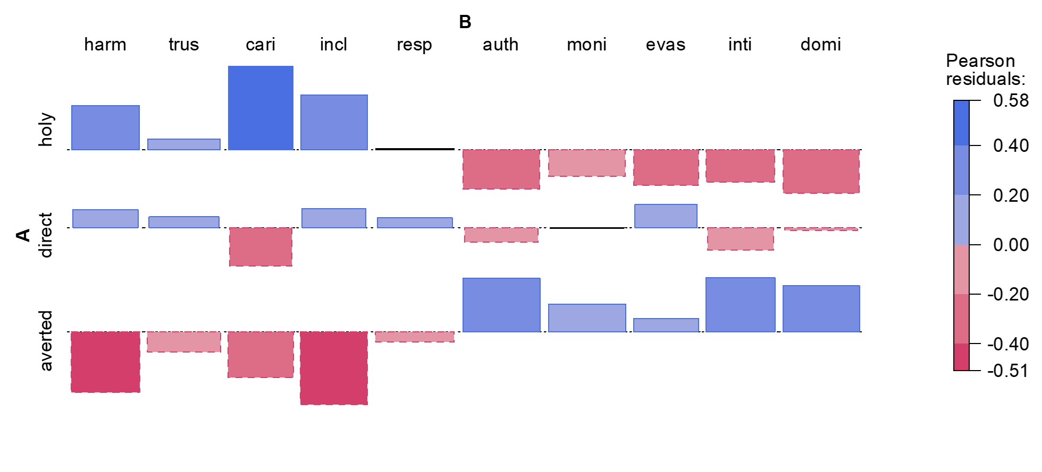
Experiment 3: Holy Faces and secular portraits.
Experiment 3: Holy Faces and secular portraits (1). Figure 4, right and below.
In the Experiment on the Holy Face we see a clear tendency for the Holy Face to be associated with positive adjectives. The Profile with averted/indirect gaze shows a mirror image of the assignment of traits, compared to the Holy Face.

Slide 41
Figure 4. Holy Faces and secular portraits

Slide 42
Experiment 4: Holy Faces and secular portraits (2).
This Experiment replicates all the findings in Experiment 3 for associations between adjectives and personality traits in the collection of portraits. This importantly shows that the results are robust and likely to replicate well.

Slide 43
The Holy Faces and the Dutch modern frontal faces gazing at the viewer were regarded to be more caring, trustworthy, harmonic, inclusive and respectable. (…)in both Experiment 1 and 2 profiles with direct gaze got a lower score.

Slide 44
Although the effects are more uncertain for Experiment 2 (Brazilian), our findings indicate that the frontal Holy Face may be more than a convention, that is, deeper biological or evolutionary reasons may explain the convention.

