Slide 1
Transgender Priming in Renaissance Europe
Christer Johansson, Per Olav Folgerø, Alf Edgar Andresen
University of Bergen, Norway

Slide 2
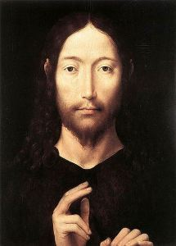
Notes:
Hans Memling, late 15th c.

Slide 3
Jesus did not always look like this Jesus
What are the causes for the transformation of Christ?

Slide 4
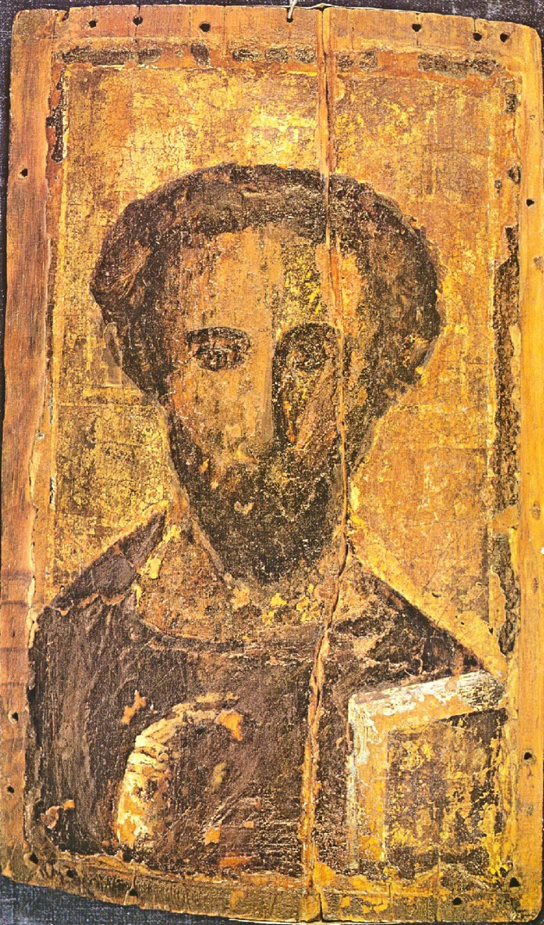
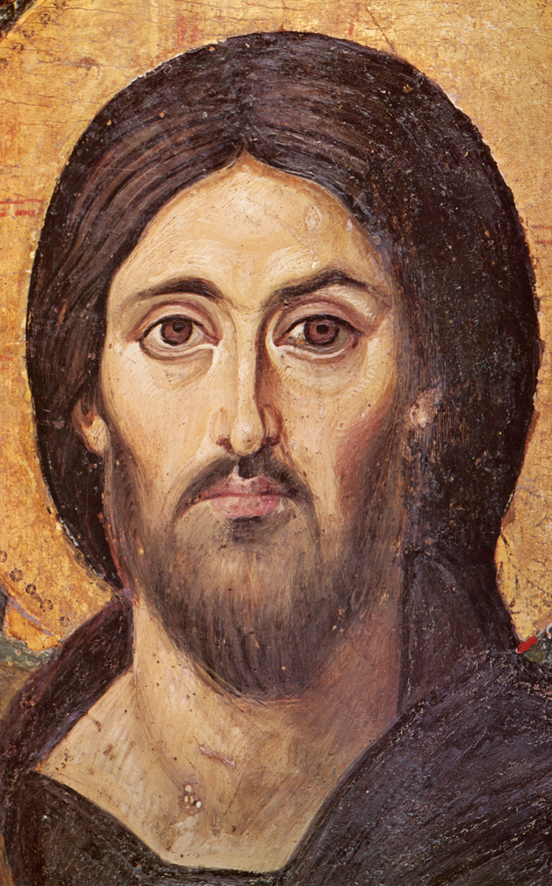
B6
B1

Slide 5
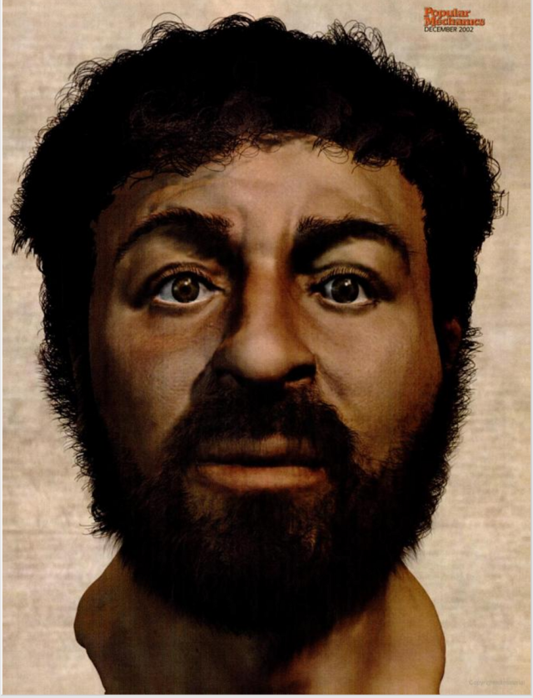
How did Jesus
The “real” face of Jesus, according to
Popular Mechanics:
http://www.popularmechanics.com/
science/health/a234/1282186/

Slide 6
How did Jesus

Slide 7
How did Jesus
The “real” face of Jesus, according to
Popular Mechanics:
http://www.popularmechanics.com/
science/health/a234/1282186/

Slide 8
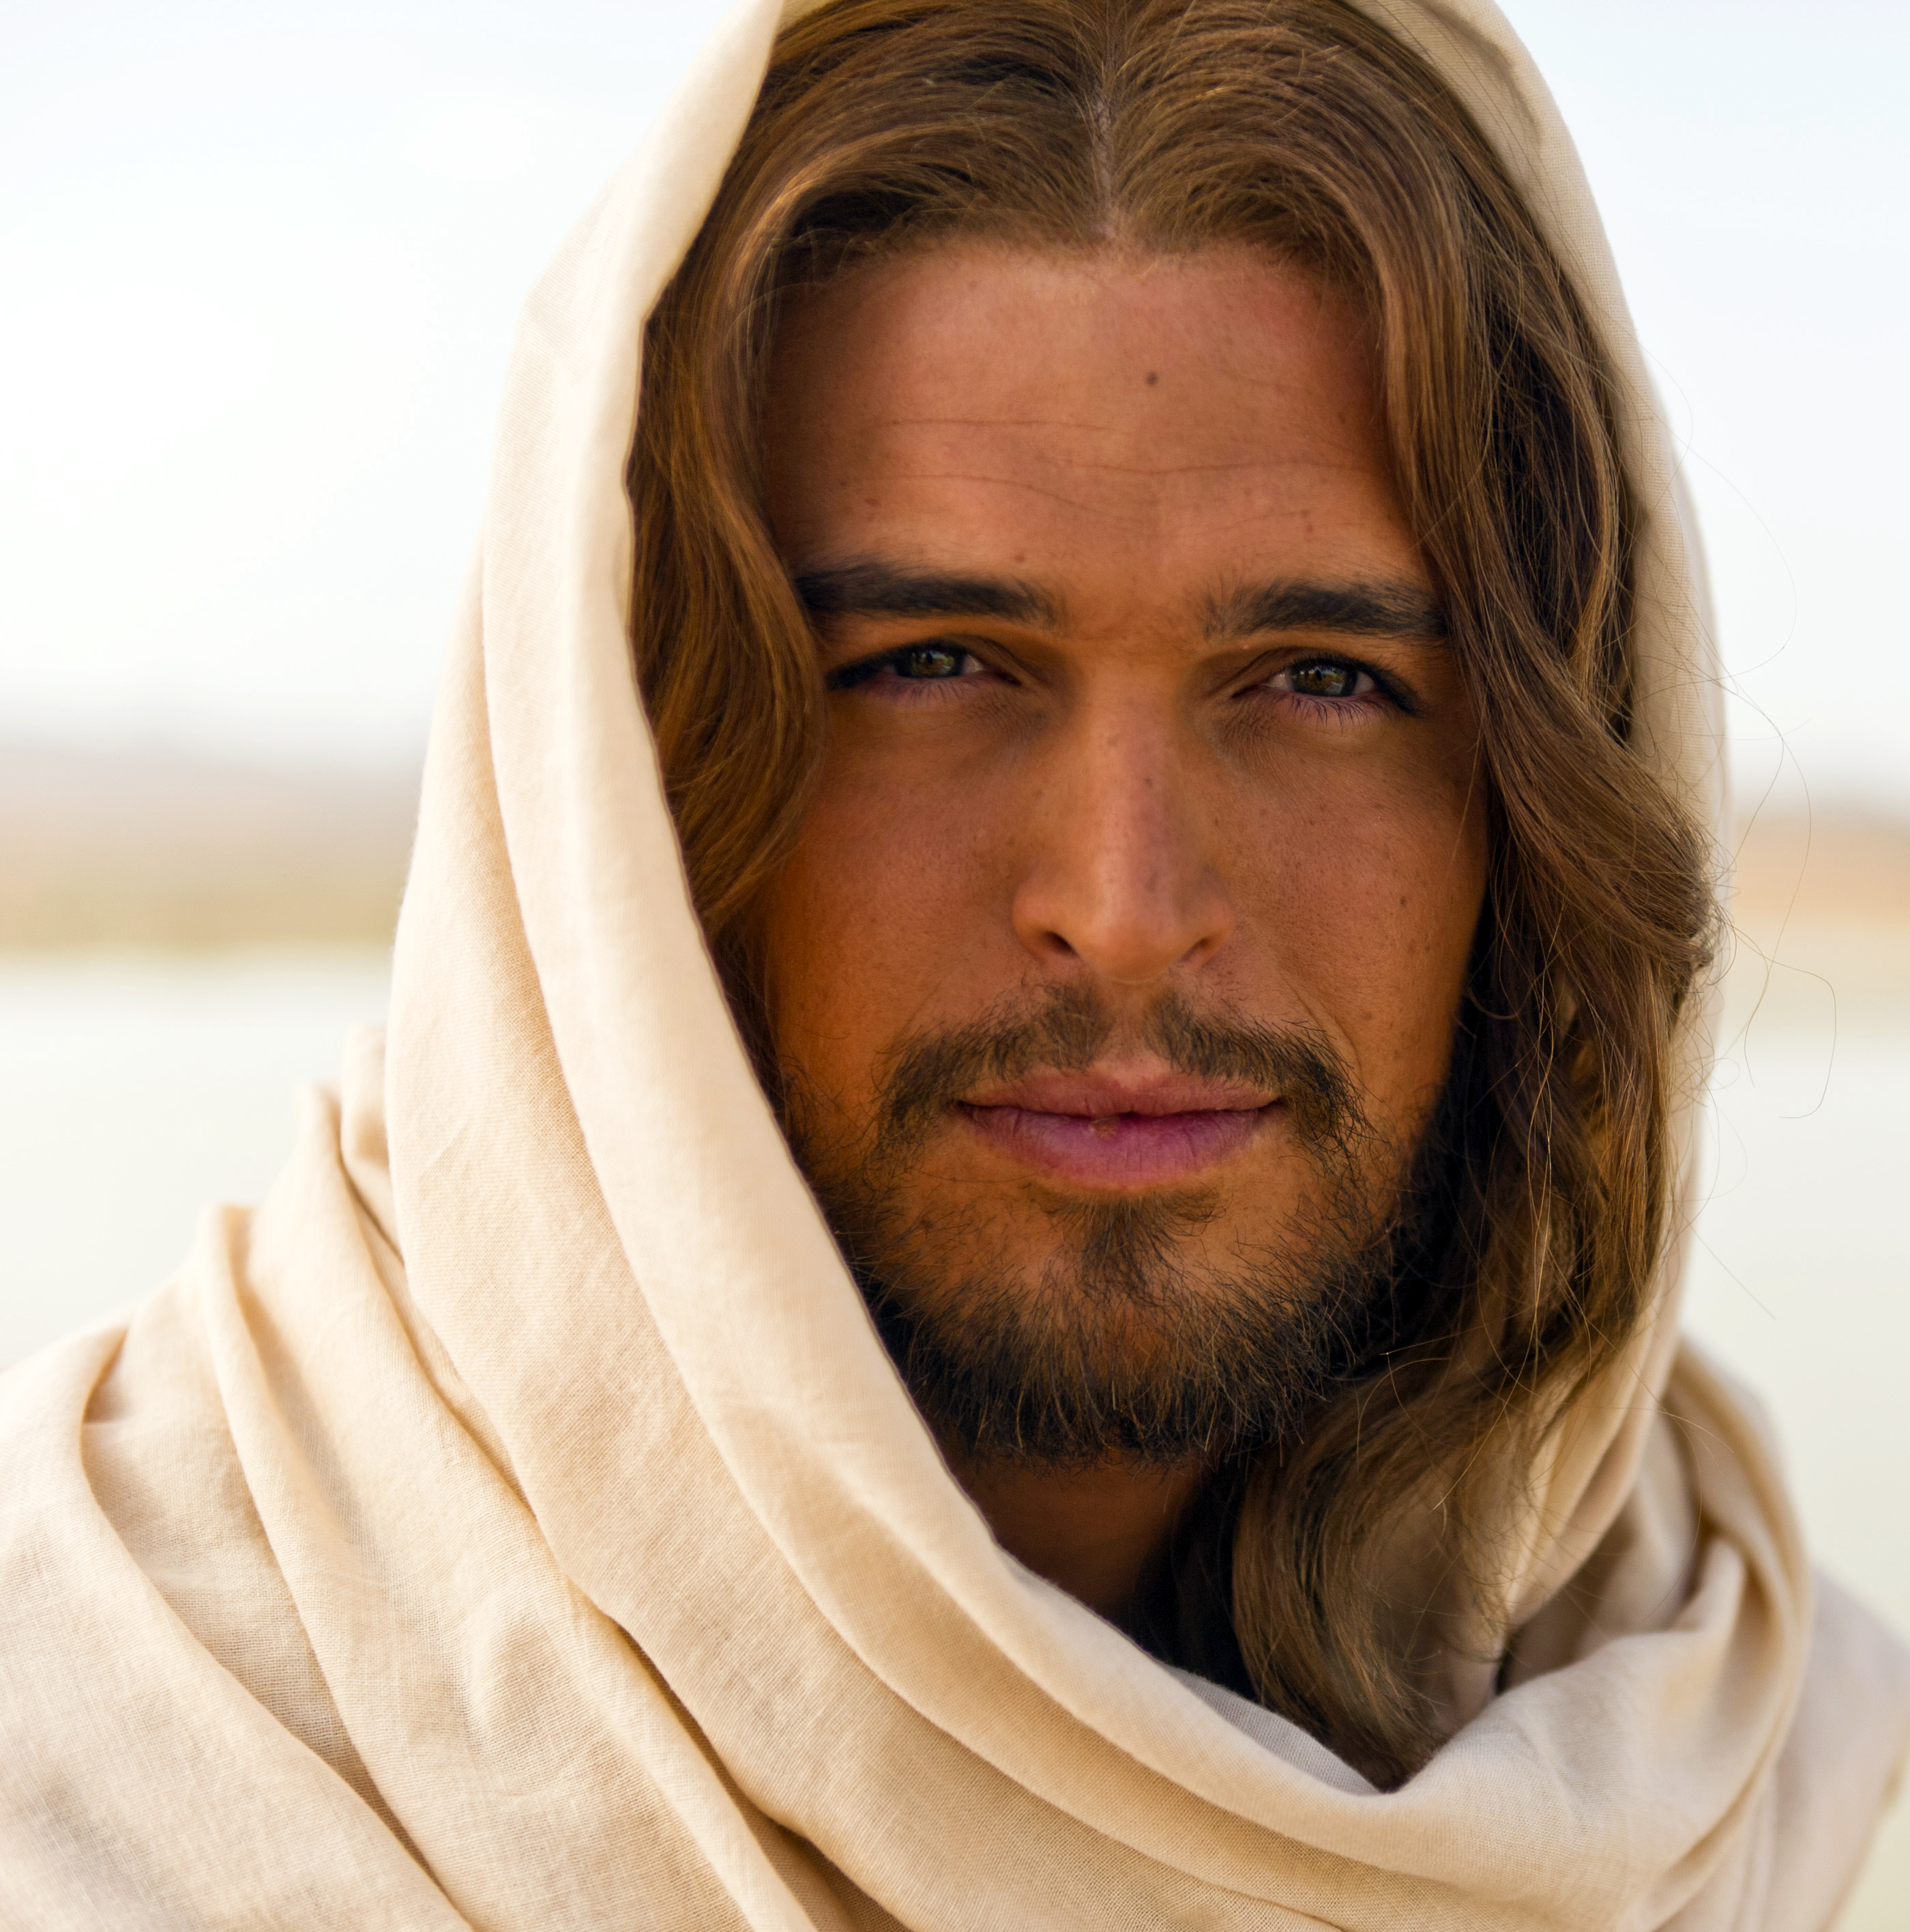
Come to look like this?

Slide 9
Come to look like this feminine face?

Slide 10
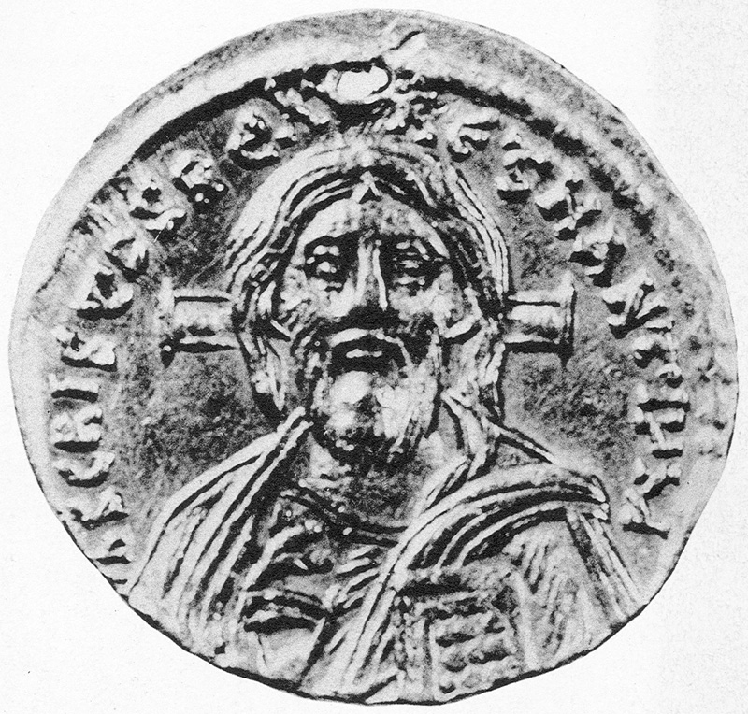
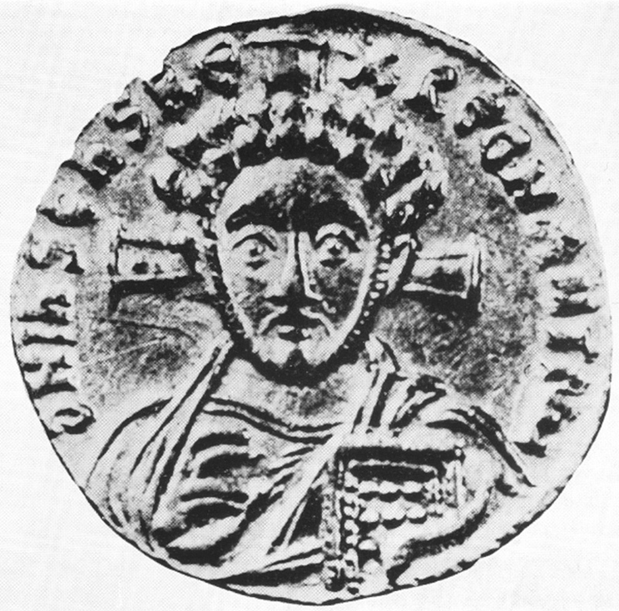

Slide 11
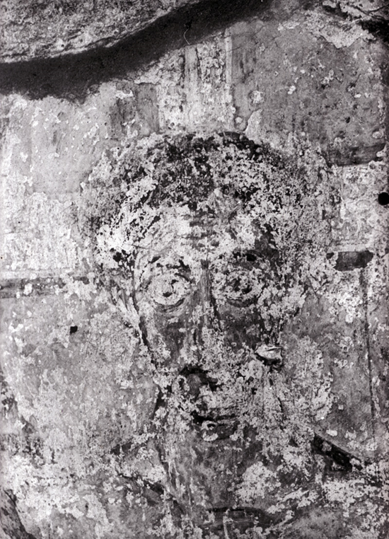
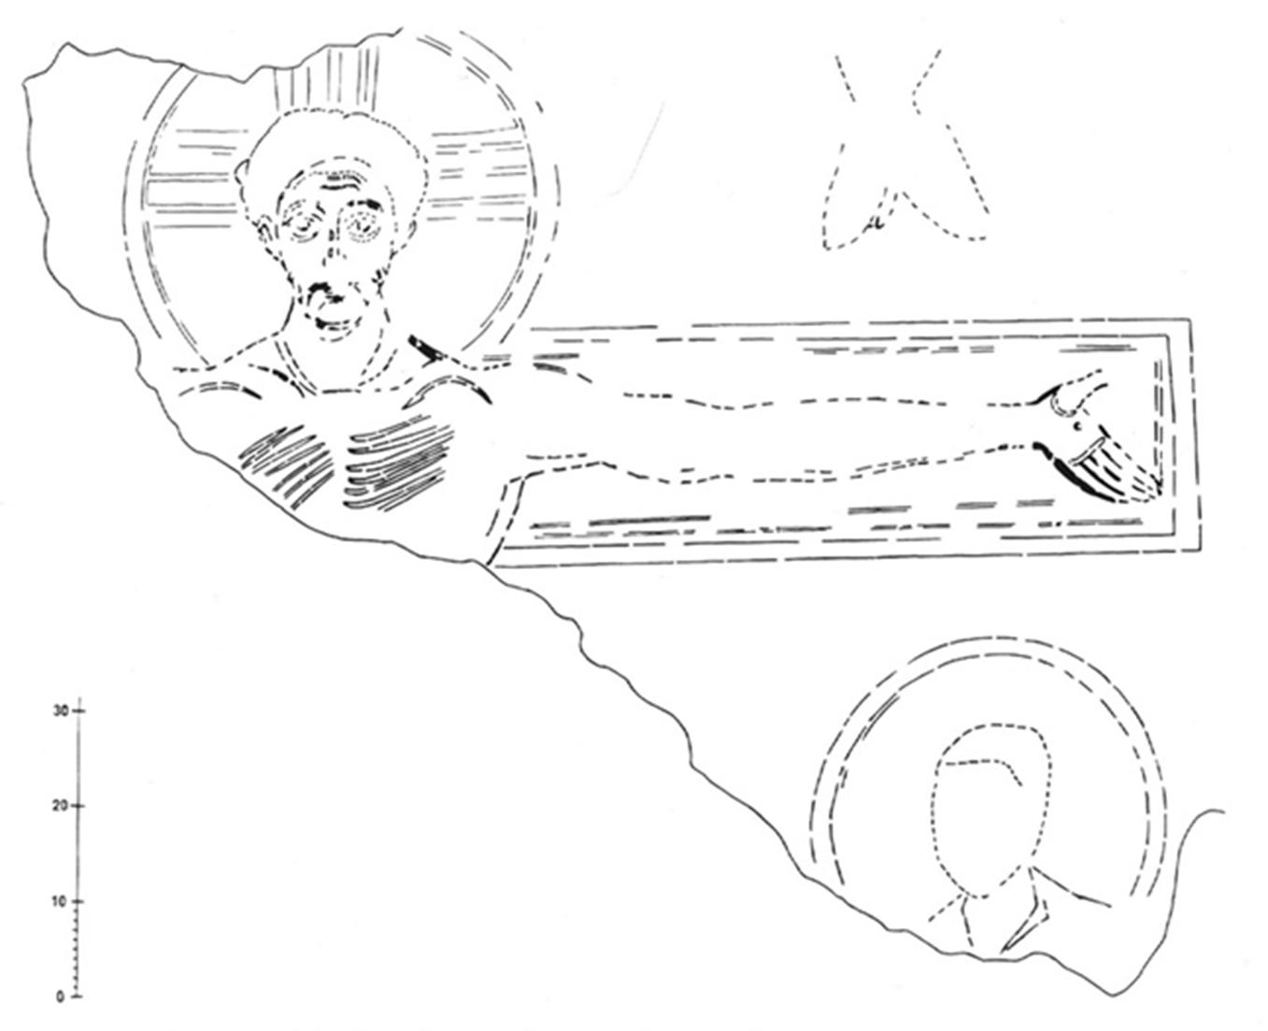
Latest known representation of Christ Type B (curly hair): Crucifixion scene S. Maria Antiqua, Rome (705-707 A.D.). Photo and tracing by P. J. Nordhagen
Notes:
hagen

Slide 12
The renaissance
The Holy Face (Christ as God) is strictly symmetrical, gazing at you.

Slide 13
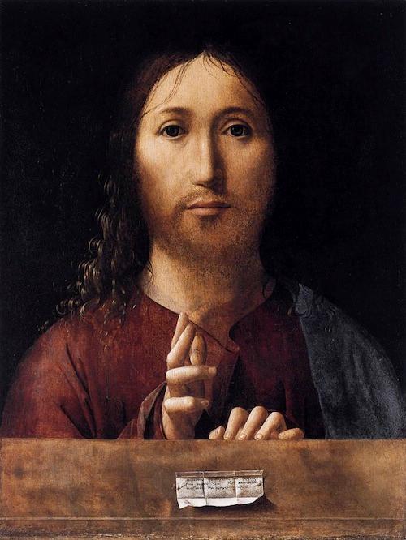

Slide 15
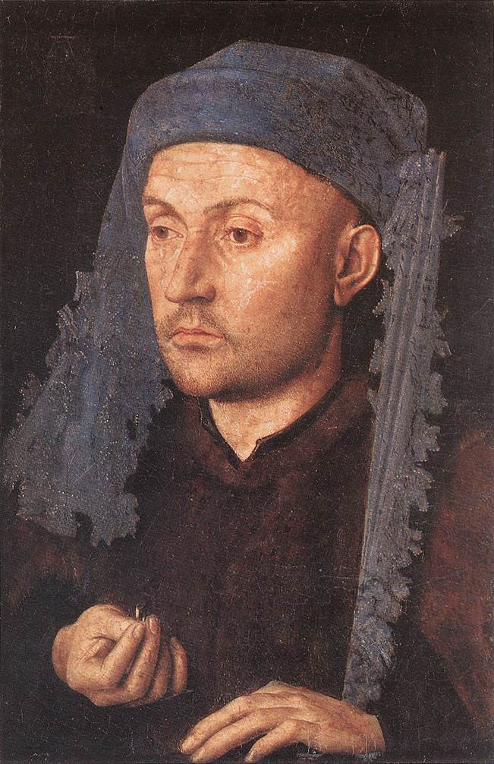
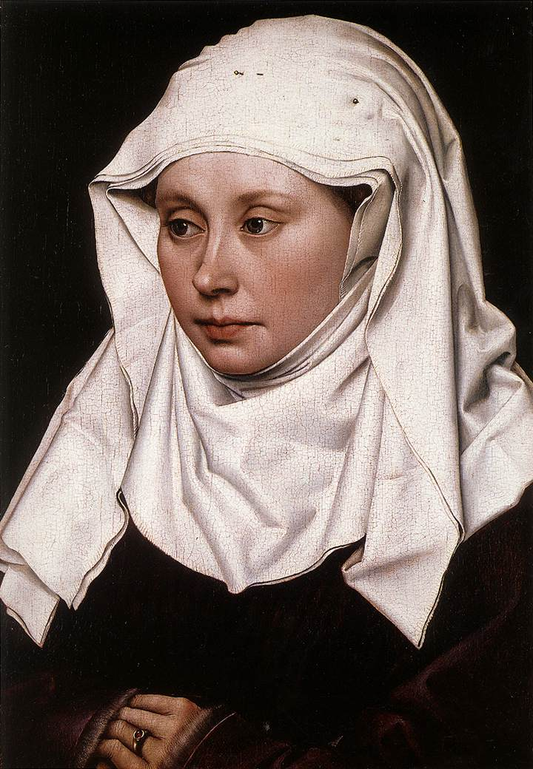
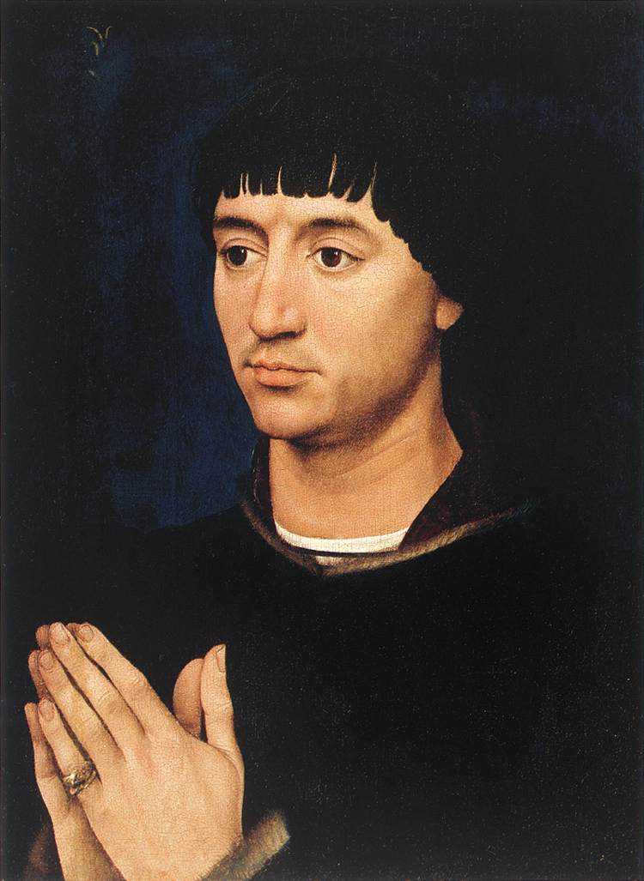
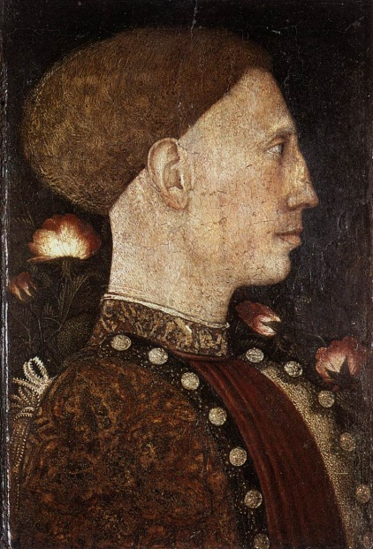
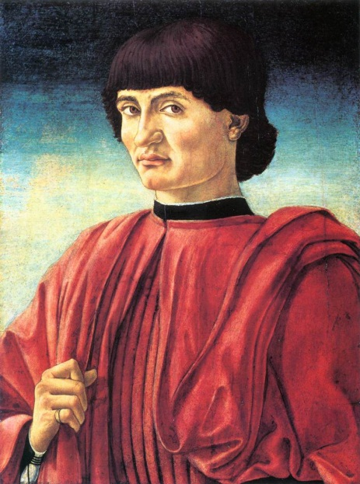
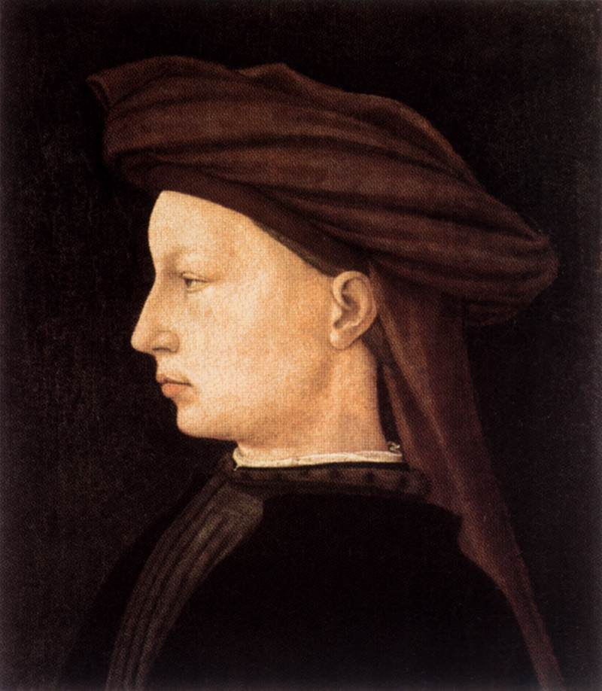
Notes:
Van Eyck, Flémalle-m, R v d Weyden, Pisanello, Castagno, Masaccio

Slide 16
The renaissance
The Holy Face (Christ as God) is (almost/intended to be) strictly symmetrical, gazing at you.
The androgyny of the Holy Face.
Two dimensions: symmetry and androgyny.

Slide 17
The renaissance
The Holy Face (Christ as God) is intended to be strictly symmetrical, gazing at you.
The androgyny of the Holy Face.
Two dimensions: symmetry and androgyny.

Slide 18
The renaissance
The Holy Face (Christ as God) is intended to be strictly symmetrical, gazing at you.
The androgyny of the Holy Face.
Two dimensions: symmetry and androgyny.

Slide 19
The renaissance
The Holy Face (Christ as God) is intended to be strictly symmetrical, gazing at you.
The androgyny of the Holy Face.
Two dimensions: symmetry and androgyny.

Slide 21
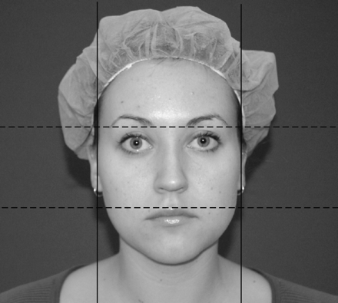
Mearurement of the facial width-to-height-ratio (fWHR) as defied by:

Slide 22
Measurement of the facial width-to-height-ratio (fWHR) as defined by:

Slide 23
Facial Width to Height Ratio
in men: mean = 1.86
in females: mean = 1.80

Slide 24
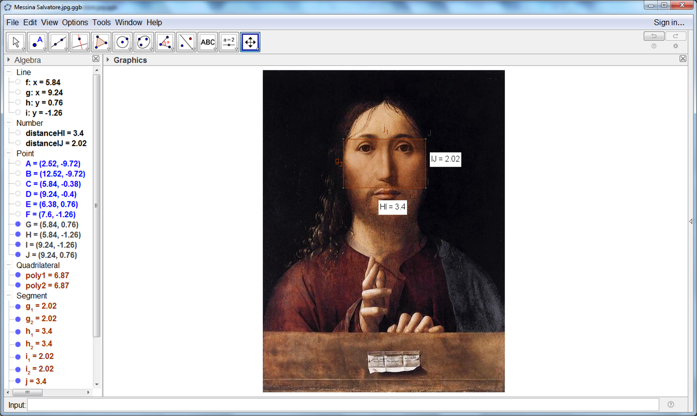

fWHR=3.4 / 2.02=1.7
Notes:
fWHR=3,4 / 2,02=1,68

Slide 25
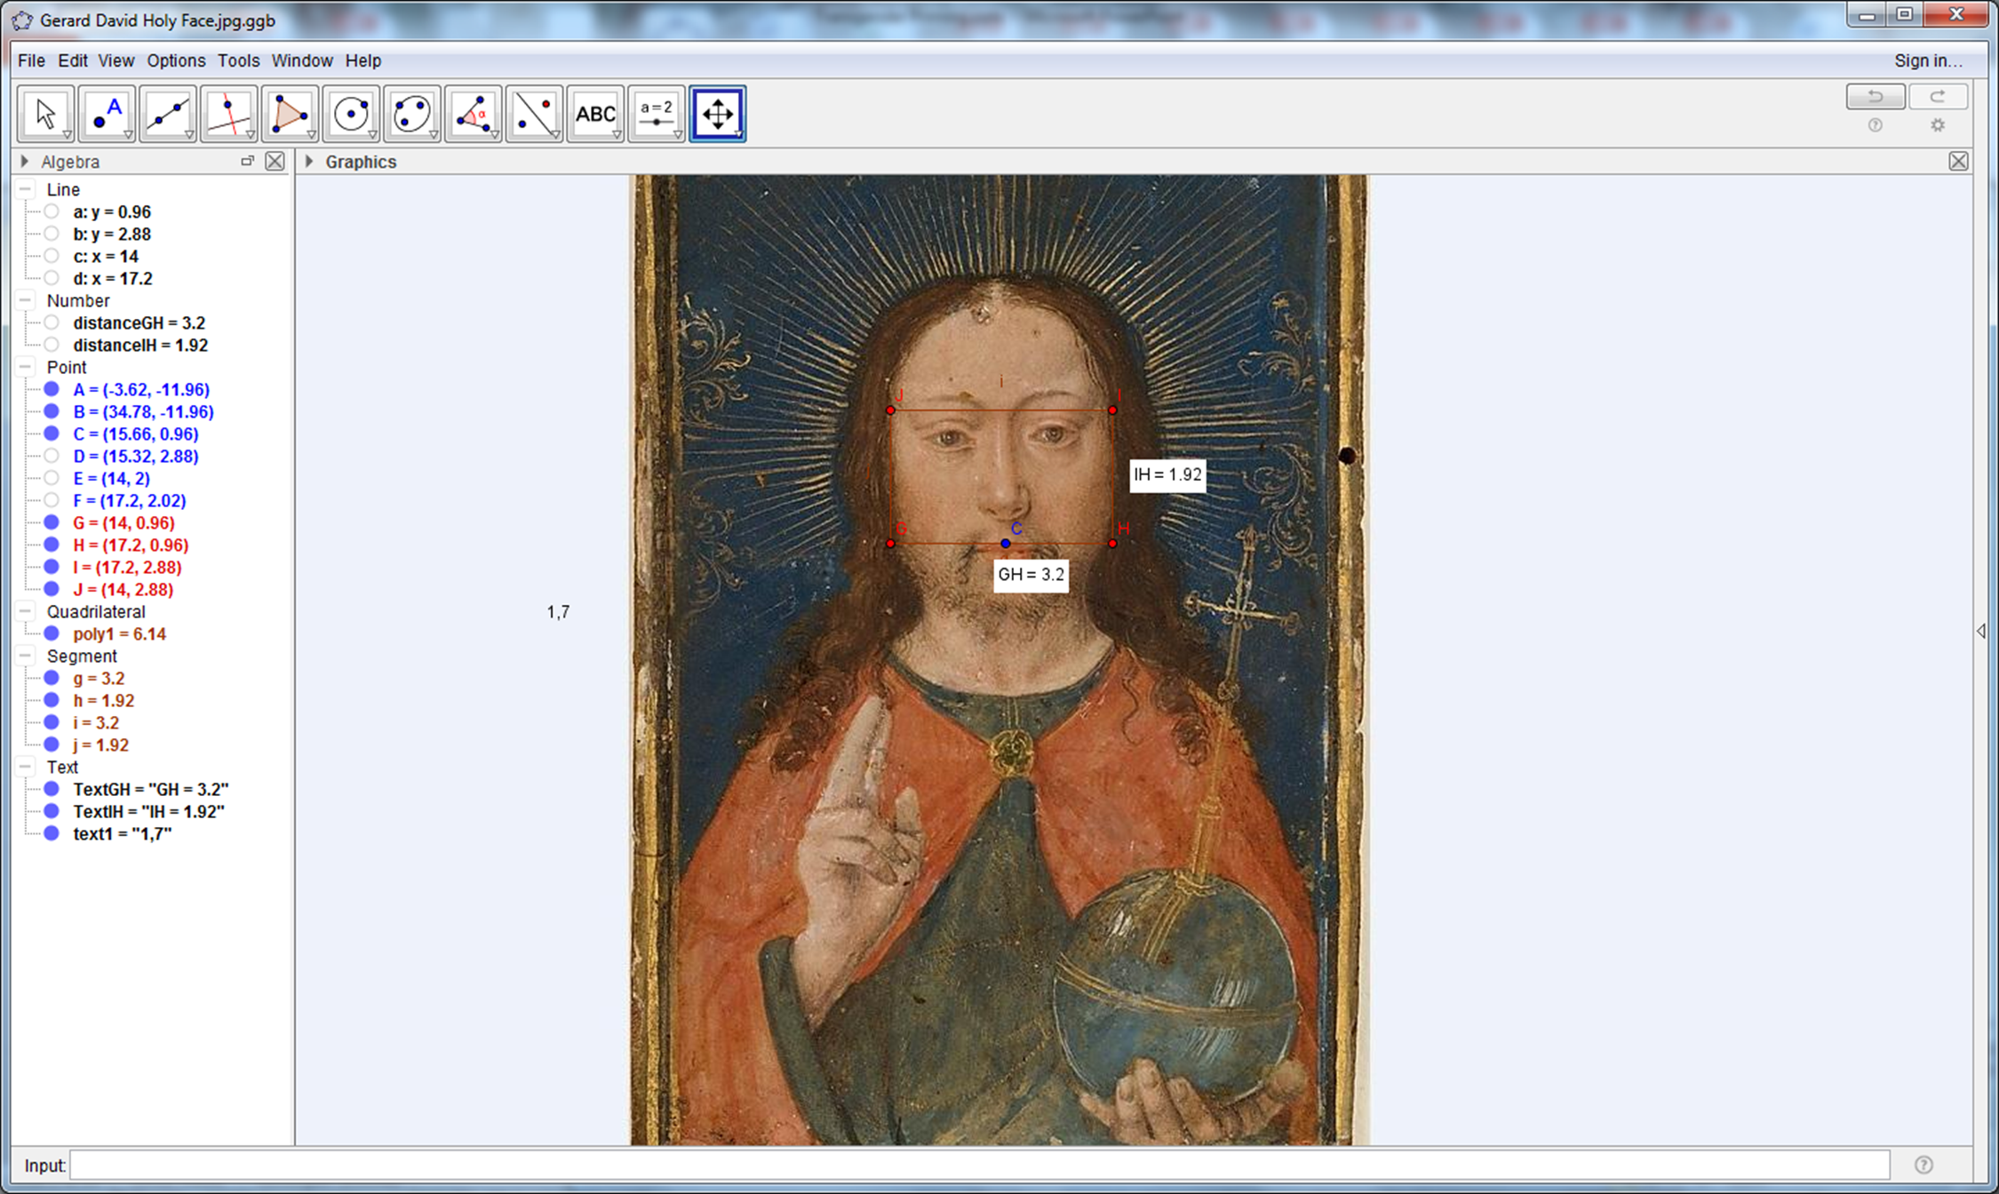
fWHR=3.2 / 1.92=1.7

Slide 26
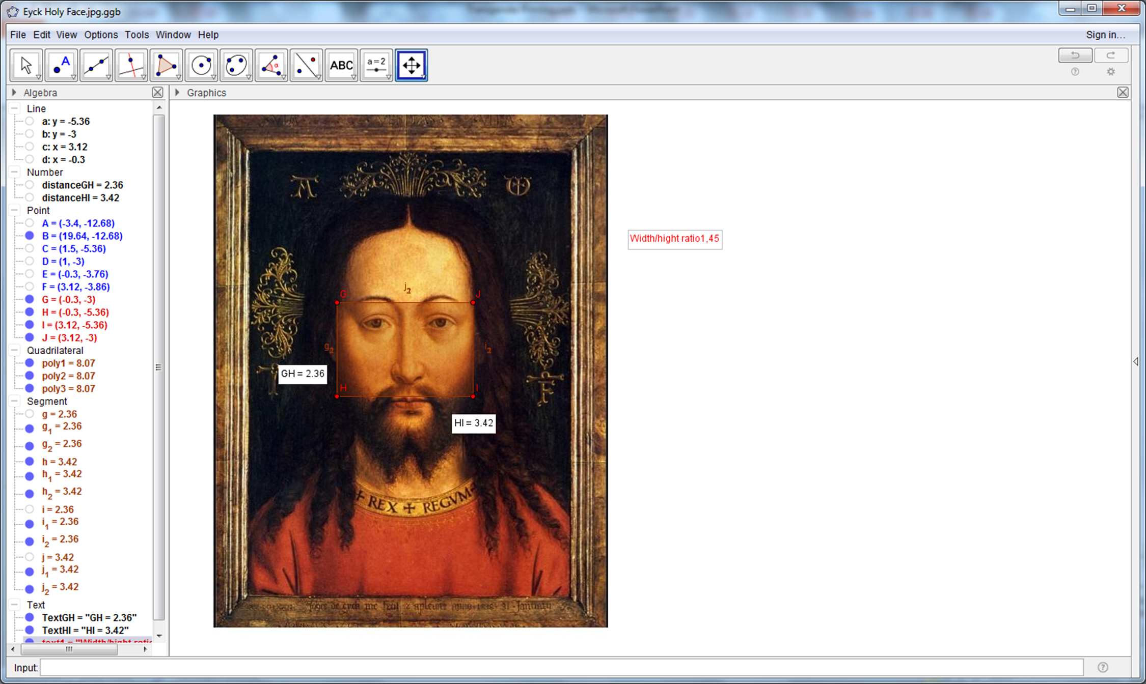
fWHR=1.45

Slide 27
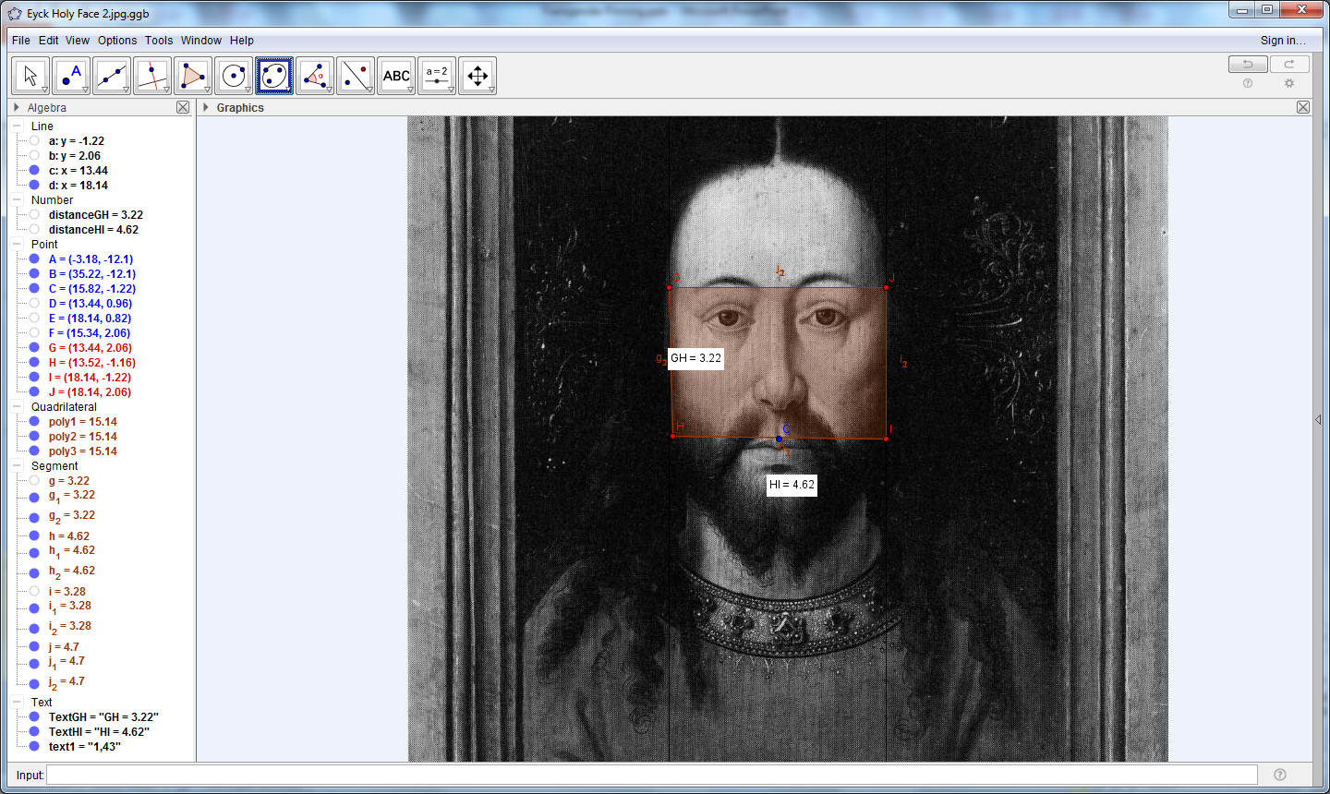
fWHR = 1.43
Notes:
Width/hight ratio 1,43

Slide 28
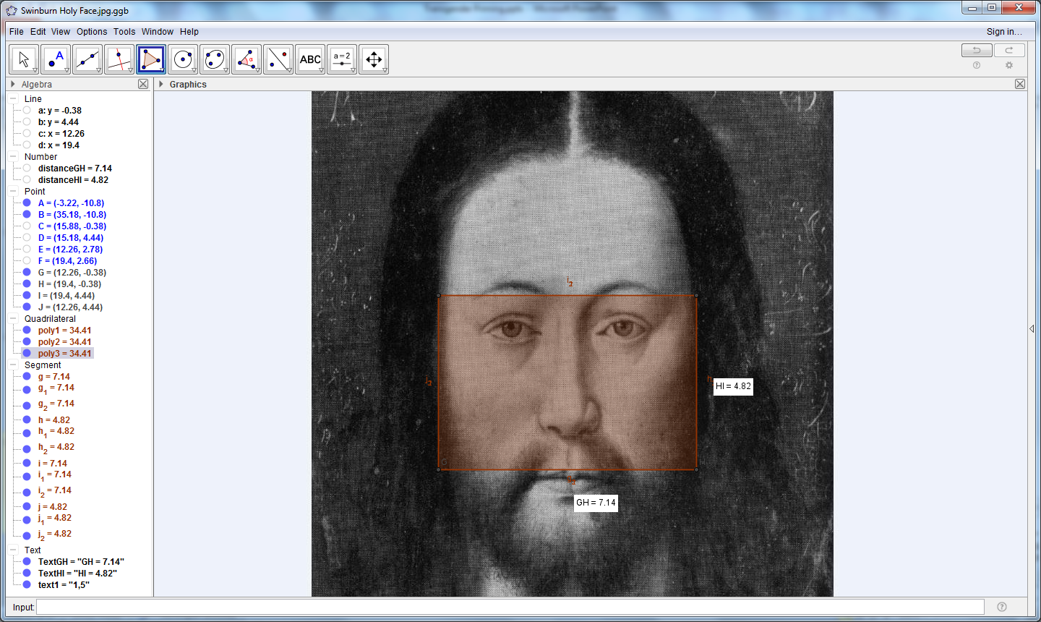
fWHR=1.5
Notes:
Width/hight ratio 1,5

Slide 29
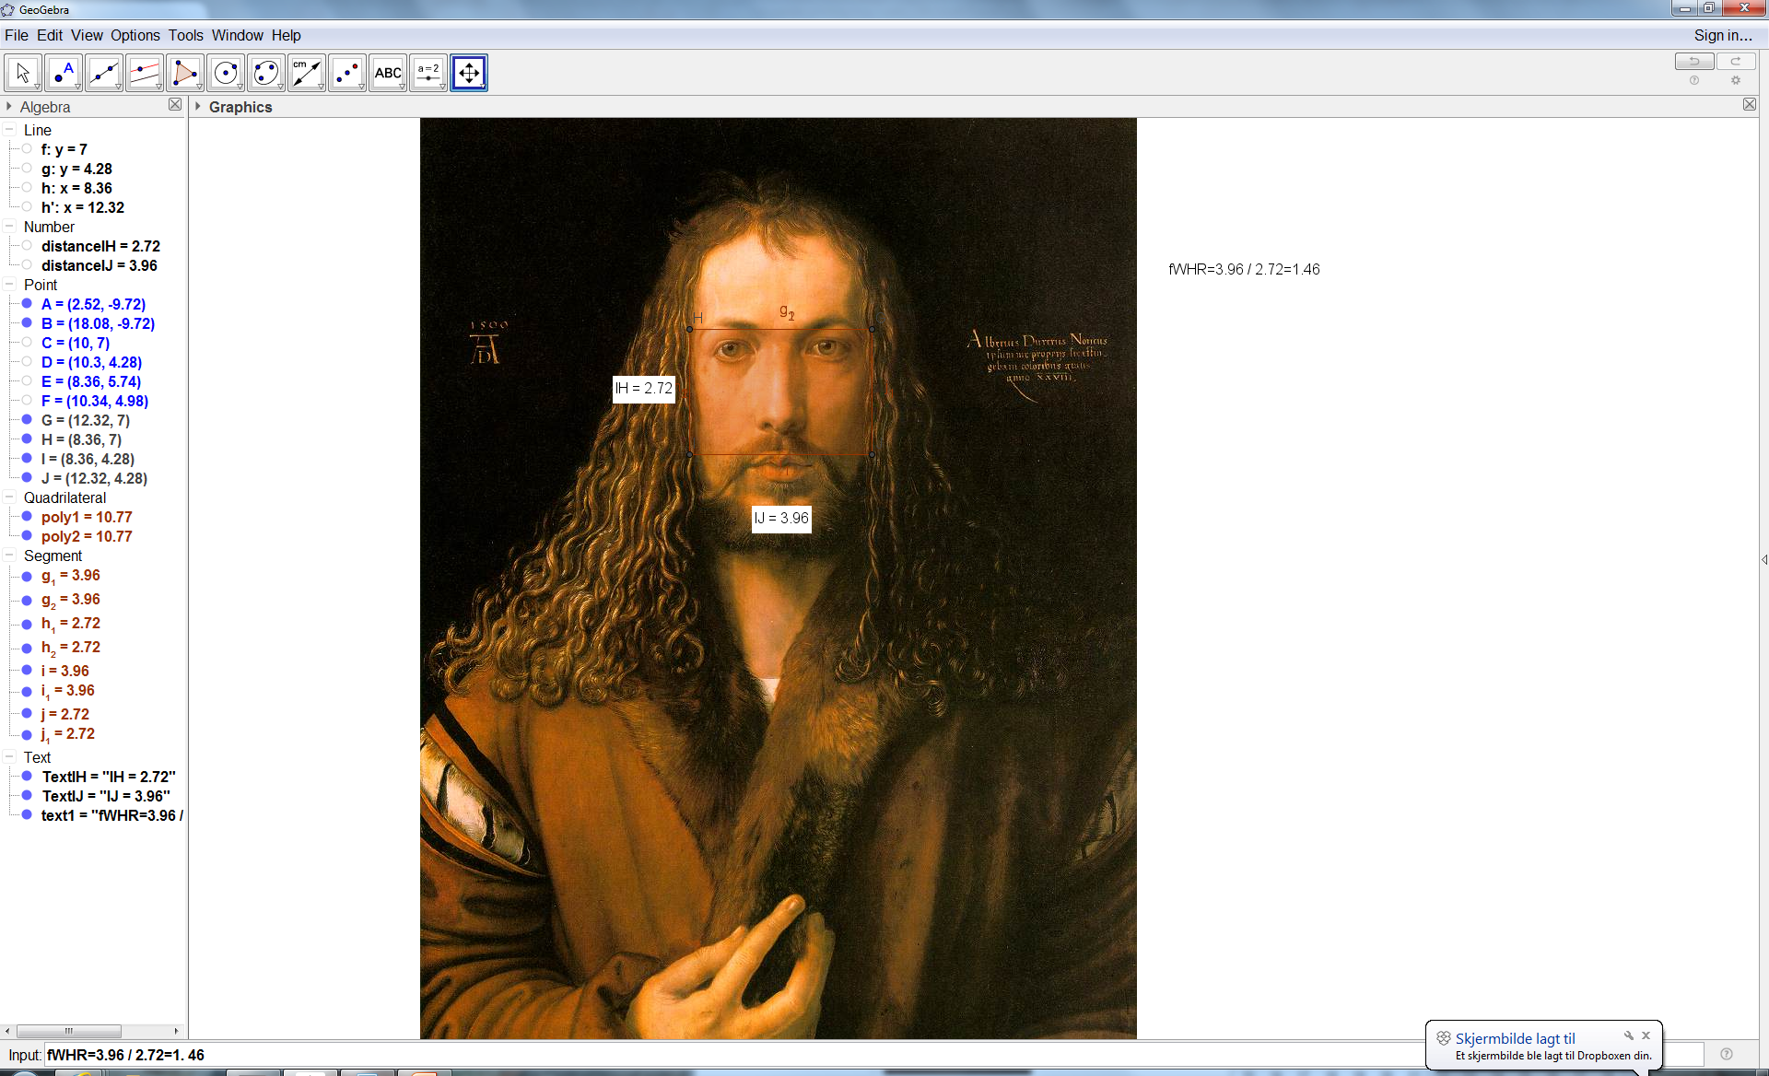

Slide 32
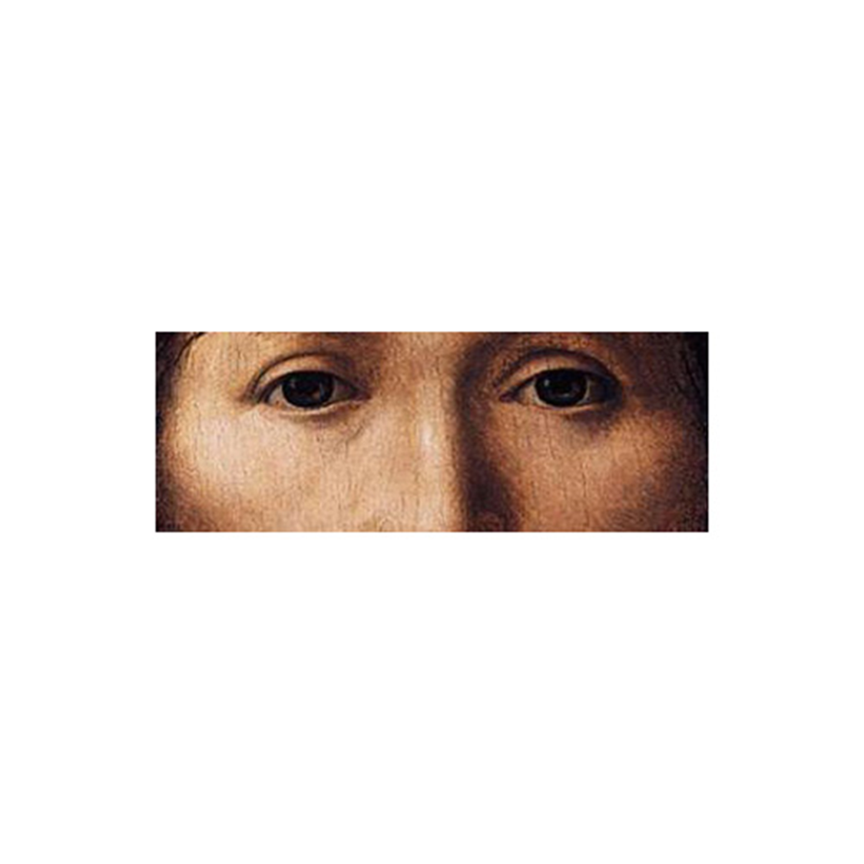

Slide 33
Word to Picture Priming
Our perception of images are in part due to how we get those images described to us.

Slide 34
Priming word «male»/»female»(50ms) – Face (1000ms)
We measure the reaction time (RT) for gender recognition

Slide 35
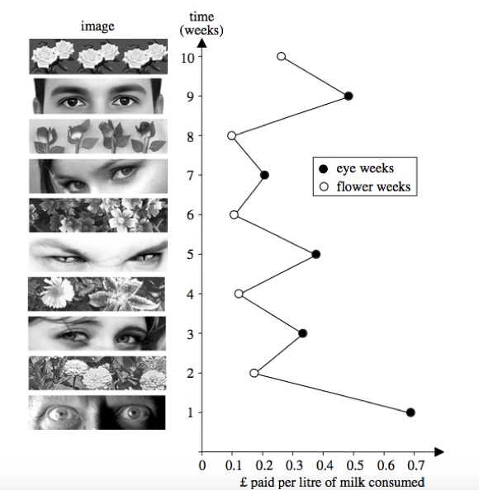
Eye Contact is a powerful stimulus
It can make you pay for free milk …
(Bateson, Nettle & Roberts, 2006. Cues of being watched enhance cooperation in a real-world setting, Biology Letters, 2, pp. 412-4).
We also show that the information can be used to reliably decide the gender of the face, in less than a second.

Slide 36
+

Slide 37
female

Slide 39
female

Slide 40
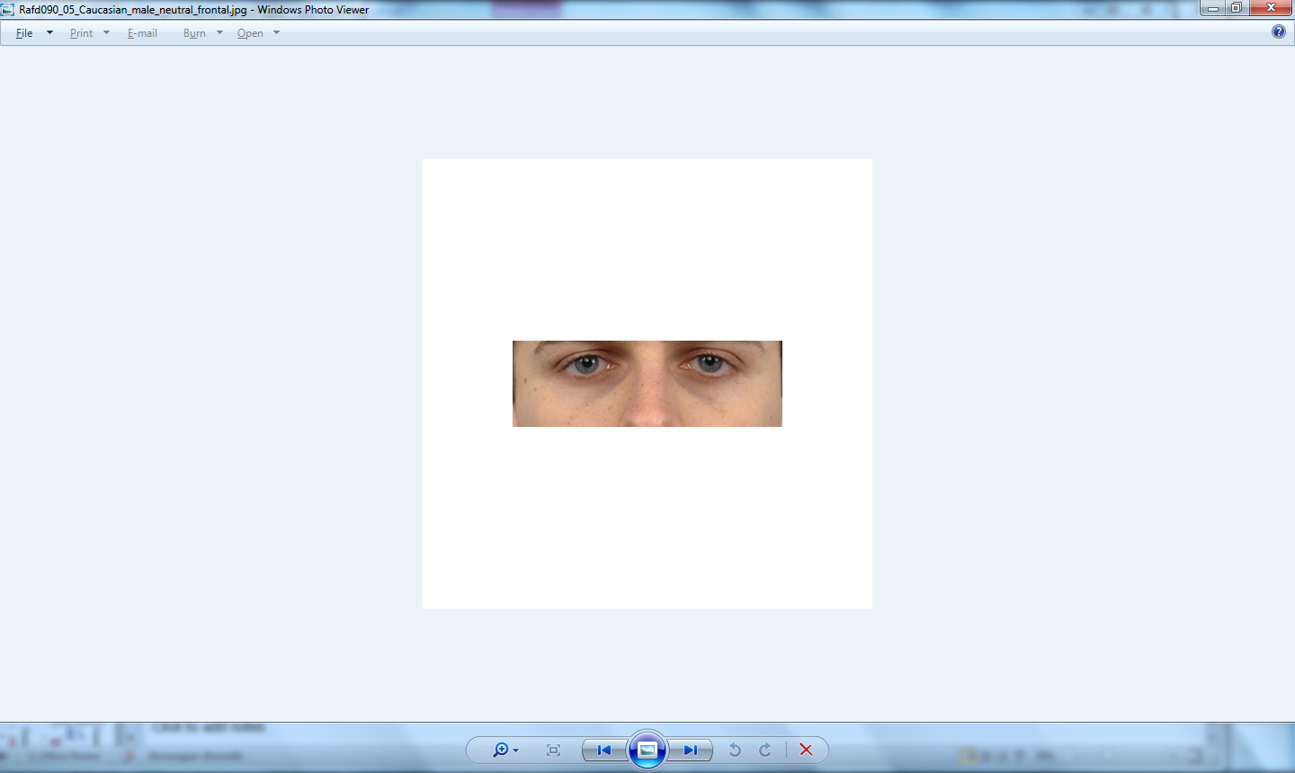

Slide 41
male

Slide 42
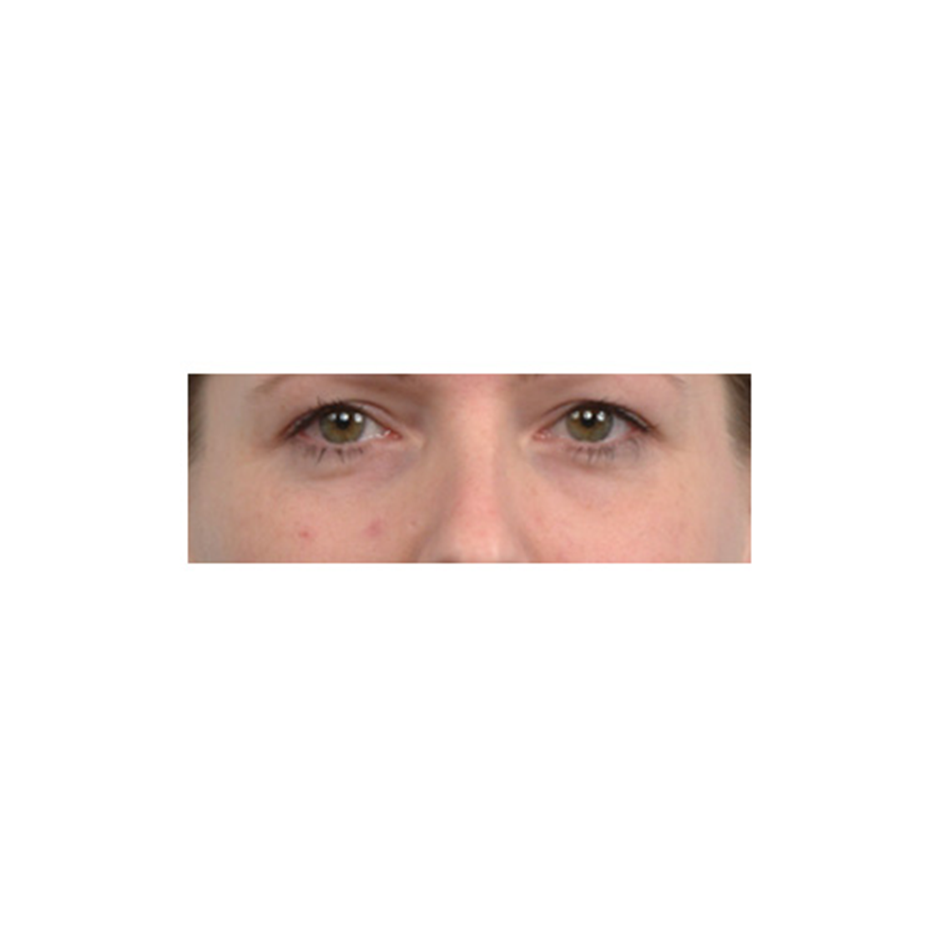


Slide 43


Slide 44
The central questions
How did the prime word affect decisions?
How did the prime word affect reaction times?

Slide 45
Jesus
When priming by “female”, Jesus is significantly more often recognized as female (overall) than expected by statistical independence.
(“Correct” in graph is the anticipated gender of the image.)
jesus male female
opposite 104(+30%) 71(-11%) 146(-10%)
correct 342(-7%) 376(+2%) 759(+2%)
Chisq(2df)=12.1;p<0.01

Slide 46
Decisions
Priming (male)
  marginal effect for Jesus
Priming (female)
  Jesus accepted as female

Slide 47
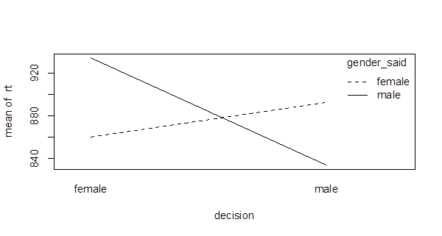
long RT
«female»
male image
decided to be male after hesitation

Slide 48
short RT
«male»
male image
decided to be male without hesitation

Slide 49
RT priming
Male images (excluding Jesus)
  Decision for female
    Faster when primed by female.
    Slower when primed by male.
  Decision for male
    Faster when primed by male.
    Slower when primed by female.
Female images
  Decision for female when primed by female.
    Decision is not dependent on prime.
    Priming has marginal influence on decided gender
      NOTE: decision for male takes longer irrespective of prime.

Slide 50
RT priming
Male images (excluding Jesus)
  Decision for female
    Faster when primed by female.
    Slower when primed by male.
  Decision for male
    Faster when primed by male.
    Slower when primed by female.
Female images
  Decision for female when primed by female.
    Decision is not dependent on prime.
    Priming has marginal influence on decided gender
      NOTE: decision for male takes longer irrespective of prime.

Slide 51
RT priming
Male images (excluding Jesus)
  Decision for female
    Faster when primed by female.
    Slower when primed by male.
  Decision for male
    Faster when primed by male.
    Slower when primed by female.
Female images
  Decision for female when primed by female.
    Decision is not dependent on prime.
    Priming has marginal influence on decided gender
      NOTE: decision for male takes longer irrespective of prime.

Slide 52
RT priming
Male images (excluding Jesus)
  Decision for female
    Faster when primed by female.
    Slower when primed by male.
  Decision for male
    Faster when primed by male.
    Slower when primed by female.
Female images
  Decision for female when primed by female.
    Decision is not dependent on prime.
    Priming has marginal influence on decided gender
      NOTE: decision for male takes longer irrespective of prime.

Slide 53
RT priming
Male images (excluding Jesus)
  Decision for female
    Faster when primed by female.
    Slower when primed by male.
  Decision for male
    Faster when primed by male.
    Slower when primed by female.
Female images
  Decision for female when primed by female.
    Decision is not dependent on prime.
    Priming has marginal influence on decided gender
      NOTE: decision for male takes longer irrespective of prime.

Slide 54
RT priming
Male images (excluding Jesus)
  Decision for female
    Faster when primed by female.
    Slower when primed by male.
  Decision for male
    Faster when primed by male.
    Slower when primed by female.
Female images
  Fast decision for female when primed by female, but also when primed by male.
    Priming has marginal influence on decided gender
      NOTE: decision for male takes longer irrespective of prime.

Slide 55
RT priming
Male images (excluding Jesus)
  Decision for female
    Faster when primed by female.
    Slower when primed by male.
  Decision for male
    Faster when primed by male.
    Slower when primed by female.
Female images
  Fast decision for female when primed by female, but also when primed by male.
    Priming has marginal influence on decided gender
      NOTE: decision for male takes longer irrespective of prime.

Slide 56
RT priming
Male images (excluding Jesus)
  Decision for female
    Faster when primed by female.
    Slower when primed by male.
  Decision for male
    Faster when primed by male.
    Slower when primed by female.
Female images
  Fast decision for female when primed by female, but also when primed by male.
    Priming has marginal influence on decided gender
      NOTE: decision for male takes longer irrespective of prime.

Slide 57
RT priming
Male images (excluding Jesus)
  Decision for female
    Faster when primed by female.
    Slower when primed by male.
  Decision for male
    Faster when primed by male.
    Slower when primed by female.
Female images
  Fast decision for female when primed by female, but also when primed by male.
    Priming has marginal influence on decided gender: no interaction effect
      NOTE: decision for male takes longer irrespective of prime.

Slide 58
RT priming
Male images (excluding Jesus)
  Decision for female
    Faster when primed by female.
    Slower when primed by male.
  Decision for male
    Faster when primed by male.
    Slower when primed by female.
Female images
  Fast decision for female when primed by female, but also when primed by male.
    Priming has marginal influence on decided gender
      NOTE: decision for male takes longer irrespective of prime.

Slide 59
RT priming
Jesus
Faster for female when primed by female.
Faster for male when primed by male.

Slide 60
RT priming
Jesus
Faster for female when primed by female.
Faster for male when primed by male.

Slide 61
RT priming
Jesus
Faster for female when primed by female.
Faster for male when primed by male.

Slide 62
Priming
Reaction Time
Primed by male
Primed by female

Slide 63
Priming
Reaction Time
Female
  Primed female (vs. male)
    faster decision for female
    faster decision for male
    No interaction

Slide 64
Conclusions: Decisions
Priming (male)
  no effect for Jesus
Priming (female)
  Jesus accepted as female

Slide 65
Conclusions: Priming
Reaction Time
Jesus
  Primed female (vs. male)
    faster decision for female*
    slower decision for male
    Interaction effect
    Classic priming
*

Slide 66
Conclusion: Priming
Reaction Time
Male
  Primed female (vs. male)
    faster decision for female*
    slower decision for male
    Interaction effect
    Similar but smaller effect than for Jesus
*

Slide 67
Conclusions: Priming
Reaction Time
Jesus
    Slower responses overall
    (100 – 150ms slower than Male/Female images)
    More hesitation / more ambiguity
    Classic priming

Slide 68
Discussion
Decisions
Jesus is decided more often as female (i.e., other).
  than expected by statistical independence for deciding correct or other gender.
Priming “Jesus” by male does not affect decisions.
Priming “Jesus” by female increases decision for female.
RT
Jesus is generally slower to decide for gender.
  Slower RT = more hesitation
When Jesus is primed by “female”, responses for “female” increase and they are faster.
  Male images also show faster responses to female when primed by female, but the effect is smaller and the number of responses do not increase significantly.

Slide 69
Formal Analysis
(Interpretation)
People take significantly longer to decide the gender of Christ portraits, compared to deciding other male or female stimuli.
Decision is affected by image (class).
  NOT surprising
The prime word affects decisions
  NOT surprising – confirms priming!
The Jesus images stand out.
  They are more easily recognized as female than other male stimuli, and they have a larger effect of priming.

Slide 70
Conclusion:
The image of Jesus is perceived, by a modern audience, as androgynous, i.e. including cues to male and female.
Decisions
“Jesus”: the frequency of decision for female increases significantly when primed by “female”.
“Jesus”: the frequency is not affected when primed by “male”.
RT
“Jesus” takes longer to decide → more ambiguity.
Priming “Jesus” by “male” shows the largest difference (>200ms) between decision for female and male.
  I.e. the image of Jesus shows a larger effect of the male prime word.
  Indicates that it is harder to recognize without prime word.

Slide 71
Conclusions: Decisions
Priming (male)
  no effect for Jesus
Priming (female)
  Jesus accepted as female

Slide 72
Possible causes for the androgyny of Christ
Did the artists use a female model?
Is the effect intended?
  I.e. are androgyny associated with positive values (such as caring, harmonious)?
Does the effect create a more universal appeal?
Did the effect evolve by the survival of portraits?
  I.e., was the appeal of an androgynous image a cause for the increased production of such images, leading to prototypicality?
  Testable hypothesis: Does facial Width/Height ratio become more feminine over the time period? For a planned effect, we would expect little change after the change first had happened, inverse if it was not planned and depended on evolved prototypicality.

Slide 73
Possible causes for the androgyny of Christ
Did the artists use a female model?
Is the effect *intended?
  I.e. are androgyny associated with positive values (such as caring, harmonious)?
Does the effect create a more universal appeal?

Slide 74
Possible causes for the androgyny of Christ
Did the artists use a female model?
Is the effect *intended?
  I.e. are androgyny associated with positive values (such as caring, harmonious)?
Does the effect create a more universal appeal?
Did the effect evolve by the survival of portraits?
  I.e., was the appeal of an androgynous image a cause for the increased production of such images, leading to prototypicality?
  Testable hypothesis: Does facial Width/Height ratio become more feminine over the time period? For a *planned effect, we would expect little change after the change first had happened, inverse if it was not planned and depended on evolved prototypicality only.

Slide 75
Androgynous Christ
Questions?
Per.Folgero@uib.no
Christer.Johansson@uib.no
Alf Andresen@uib.no

Slide 76
Formal Analysis
(Interpretation)
People take longer to decide the gender of Christ portraits.
Decision is affected by image (class).
  NOT surprising
The prime word affects decisions
  NOT surprising – confirms priming.
The effect of priming on the decision depends on the class of stimuli.
  “Jesus” : longer time when primed by male, but if the decision is also “male” a net gain of about 70ms.
Jesus
  rt = 970.6+ -7.7*dM +103.9*pM -168.3*(dM&pM)
Significant Effect
Jesus: 120ms slower
  t(47.4)=3.16; p<0.03
Jesus x decision x prime
  t(1607.5)=-2.88; p<0.01
Class:
  F(2,29.9)=5.4; p<0.02
Class x decision:
  F(2,25.1)=6.5; p<0.01
Decision x prime:
  F(1,1693)=12.6; p<0.001
Class x decision x prime:
  F(2,1666)=4.3; p<0.02

Slide 77
Formal Analysis
(next slide, please!)
dM=decision for Male
pM=primed by male
Female
  rt = 850.3 + 65.2*dM +31.4*pM -4.1(dM&pM)
Male
  rt = 880.1 + 24.7*dM +27.3*pM -95.8*(dM & pM)
Jesus
  rt = 970.6+ -7.7*dM +103.9*pM -168.3*(dM & pM)
Significant Effect
Jesus: 120ms slower
  t(47.4)=3.16; p<0.03
Jesus x decision x prime
  t(1607.5)=-2.88; p<0.01
Class:
  F(2,29.9)=5.4; p<0.02
Class x decision:
  F(2,25.1)=6.5; p<0.01
Decision x prime:
  F(1,1693)=12.6; p<0.001
Class x decision x prime:
  F(2,1666)=4.3; p<0.02

Slide 78
