Slide 1

Prototypes and Recognition of Self in Depictions of Christ
Carla-Sophie Lembke¹, Per Olav Folgerø²,
Alf Edgar Andresen² & Christer Johansson²
University of Osnabrück, Germany
University of Bergen, Norway
Notes:
This work is a cooperation between the University of Osnabrück and the University of Bergen, made possible by an Erasmus+ Trainee Scholarship.

Slide 2
Christianity evolved over the millennium after the crucifixion
What are the causes for the transformation of Christ?
Notes:
We are often told a story that make it seem as if Christianity was a sudden success: Crucifixion and Bob’s your uncle.
The reality is that Christianity went through many transitions from a small Jewish sect to a World Religion by adaptations to the believers.
Believers were increasingly encouraged to identify with the life and deeds of Christ.
Could this have been helped by adapting the image of Christ to believers? How to include female believers?
(Many religions have not adapted to believers, and some have explicitly forbidden Religious Portraits, some exclude women from religious practice.)

Slide 3
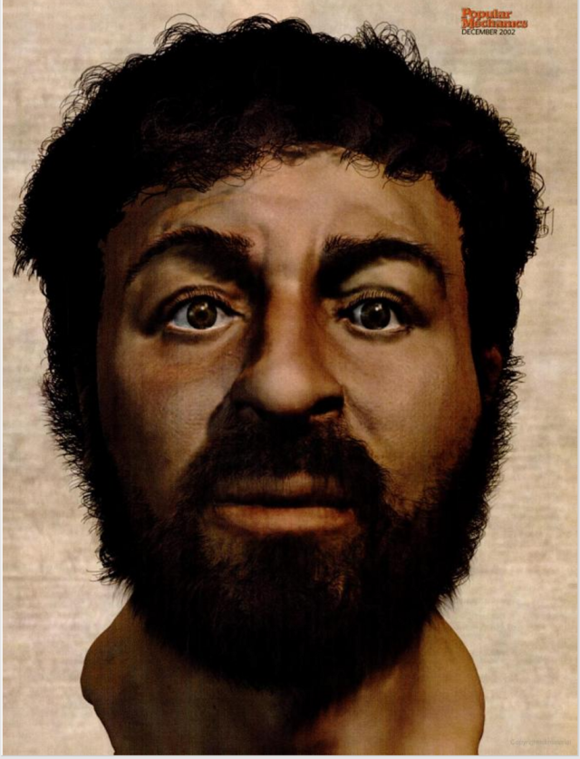
Before
The “real” face of Jesus, according to Popular Mechanics:
http://www.popularmechanics.com/science/health/a234/1282186/
Notes:
This is not how we recognize Christ today.

Slide 4

After
Notes:
What happened?

Slide 5
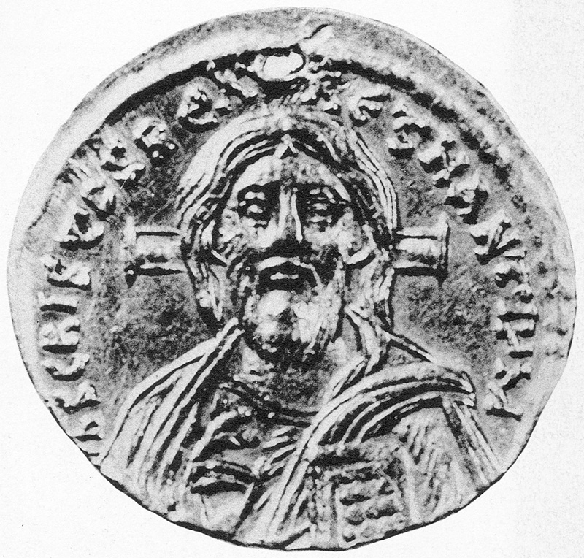
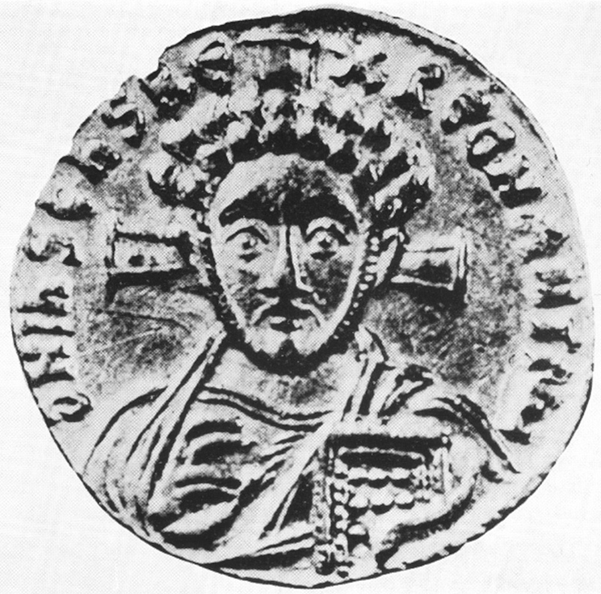
Notes:
The curly haired Christ (Type B) disappeared after Justinian II’s death in 711 A.D. Does the success of Type A have pure theological reasons, which is the common explanation, or can the answer also can be found within cognition?
In agreement with the processing fluency theory, the explanation might be that we like what we have seen before.
The representation becomes prototypical through mere exposure. Prototypes are attractive because they are easy on the mind.

Slide 6
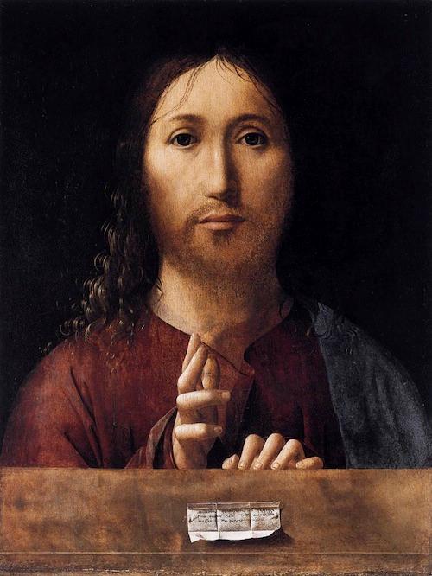
Notes:
The Renaissance: The Holy Face (Christ as God) is strictly symmetrical, gazing at you.
Folgerø et al. 2016a find that positive traits are more easily assigned to symmetric, en face, portraits, possibly as a consequence of face and gaze direction.

Slide 7
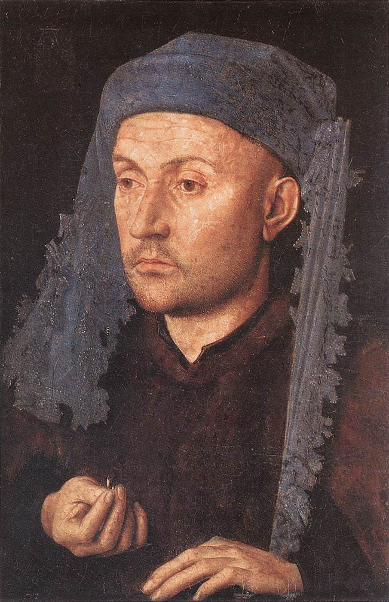
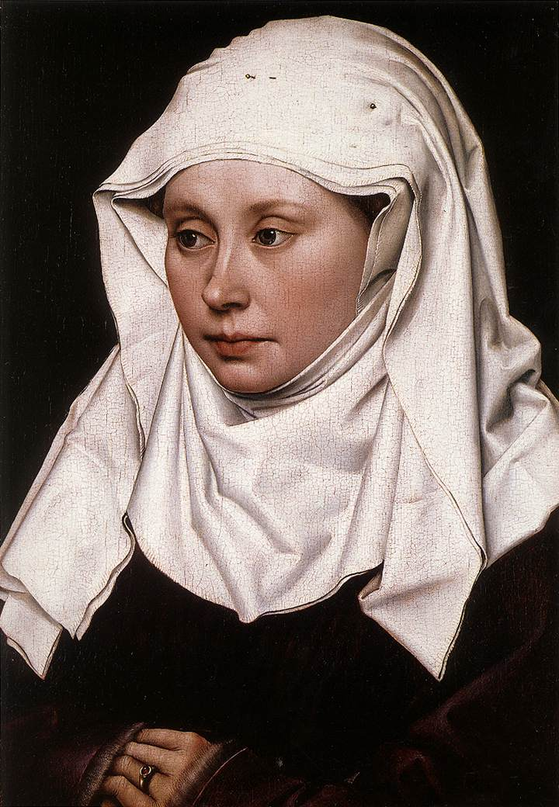
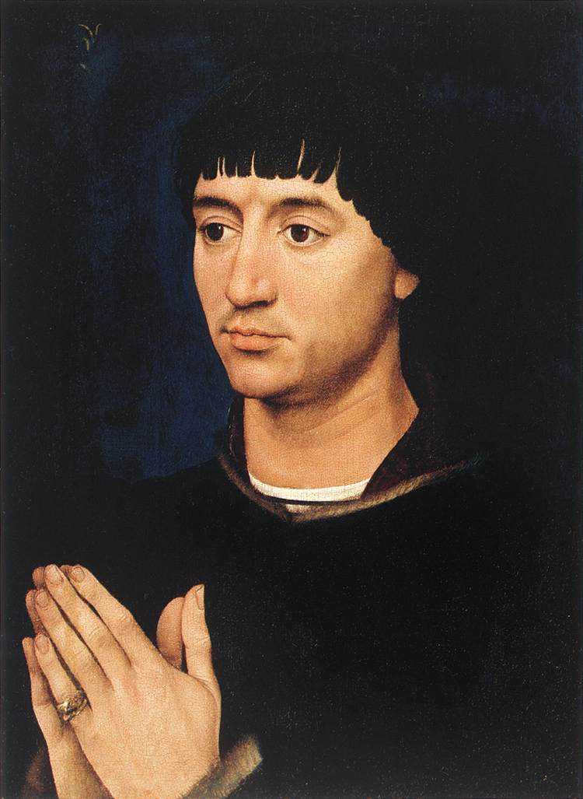
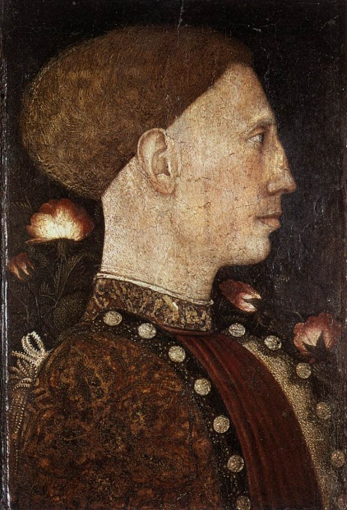
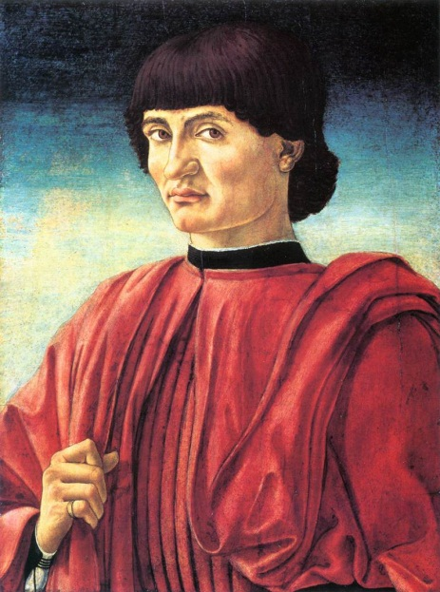
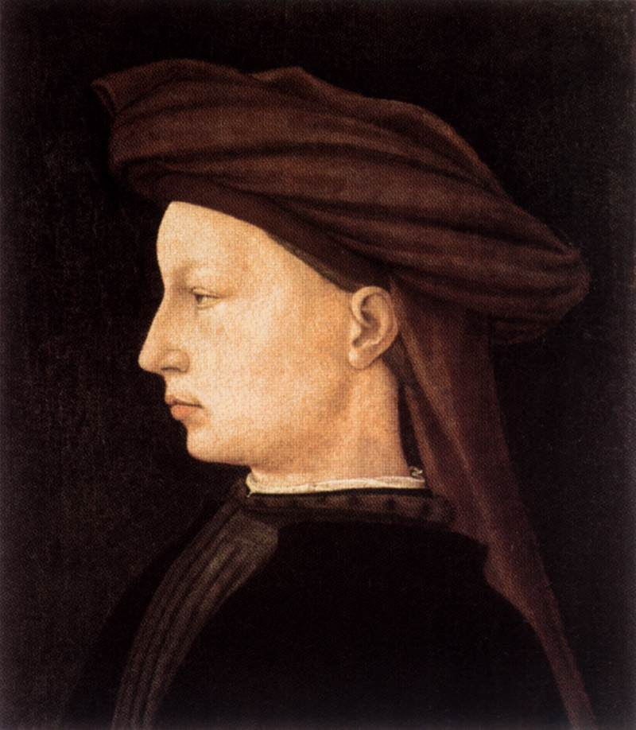
Notes:
Secular portraits were in profile!
Christ as the Man of Sorrows was also often in profile. (Van Eyck, Flémalle-m, R v d Weyden, Pisanello, Castagno, Masaccio)

Slide 8
Notes:
The face of Christ is also androgynous, as well as symmetric. Is this in order to create a more universal appeal?
Do people notice it? Can we experimentally verify that people detect and react positively to such features?

Slide 9
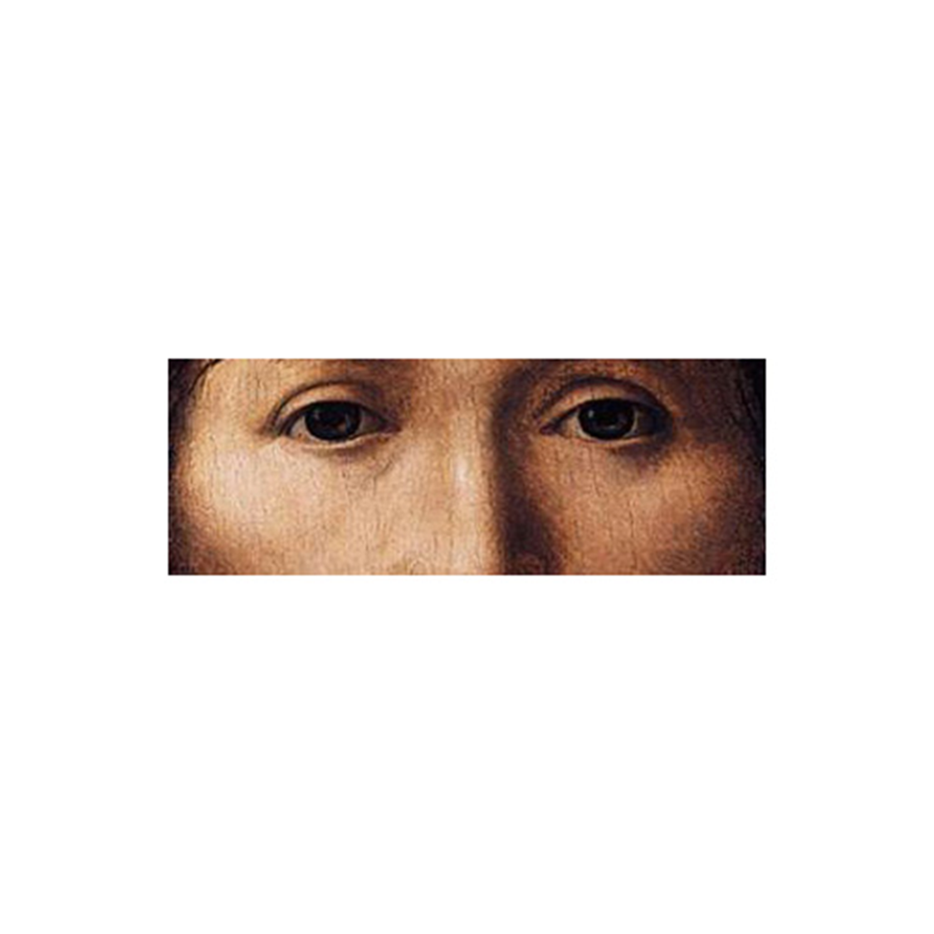
Notes:
In Folgerø et al. 2016b we restricted our stimuli to the section between eyebrows and tip of the nose.
This excludes forehead and chin, as well as hairstyle and beard.

Slide 10
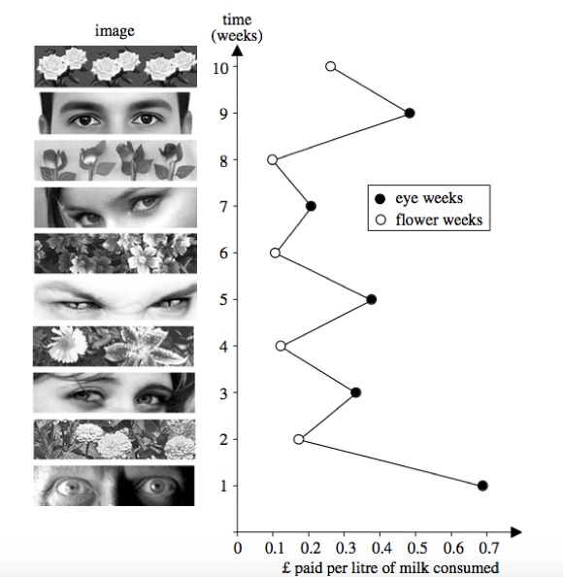
Eye Contact is a powerful stimulus
It can make you pay for free milk …
(Bateson, Nettle & Roberts, 2006. Cues of being watched enhance cooperation in a real-world setting, Biology Letters, 2, pp. 412-4).
Notes:
We can show that the information can be used to reliably decide the gender of the face, in less than a second.

Slide 11
Word to Picture Priming
Notes:
Giving words to a picture may change the weight we put on features in that picture!

Slide 12
female

Slide 14
male

Slide 15
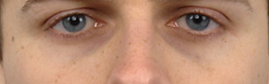

Slide 16
female

Slide 17
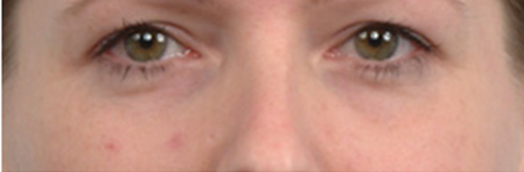

Slide 18
Results
How did the prime word affect decisions?

Slide 19
Decisions
Priming (male)
  no effect for Christ
Priming (female)
  Christ accepted as female
Notes:
Christ is recognized as female when we show the word female for 50ms before the face is shown.
Similarly priming male and female images with their “correct” gender avoids a classification as the opposite gender (red squares)!

Slide 20
The Current Study
We set up a Hot-or-Not contest.
Hypotheses
  Prototypes will be liked more
  Prototypes will be processed more fluently
  People will like images that contain themselves
    (Egocentric Beauty / Narcissist Beauty)

Slide 21
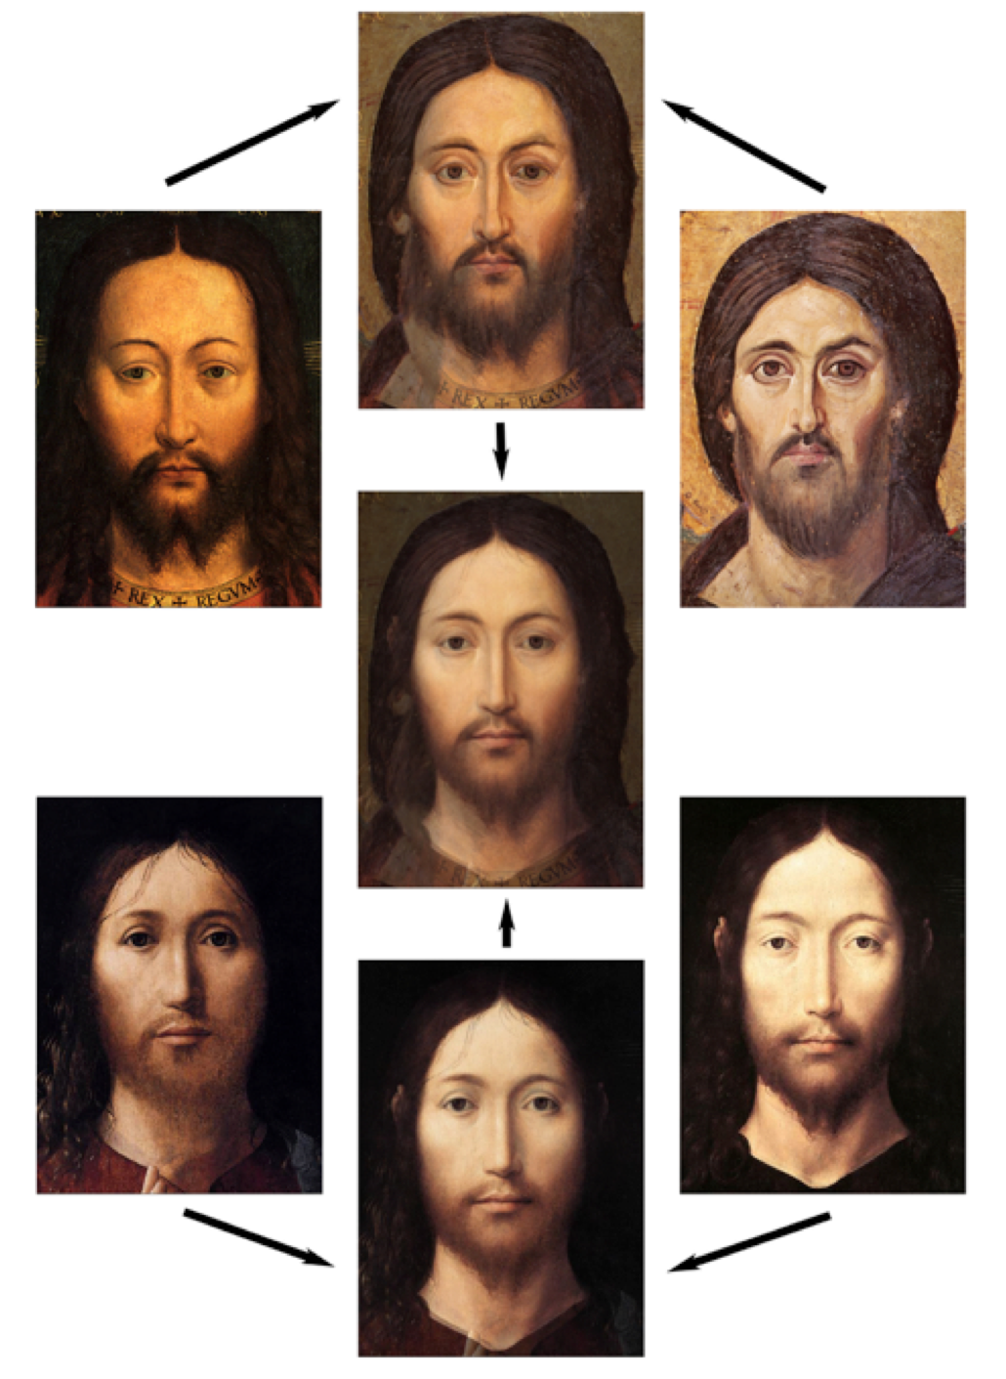
The creation of a prototype
Notes:
The middle image is the result of pairwise morphing four iconic images of Christ, as indicated by the arrows.
We keep this image as the prototype for Christ. This is also the image that is morphed with other images to create personalized images as well as
creating three new prototypes: a feminine, a neutral human, and a more male Christ.

Slide 22
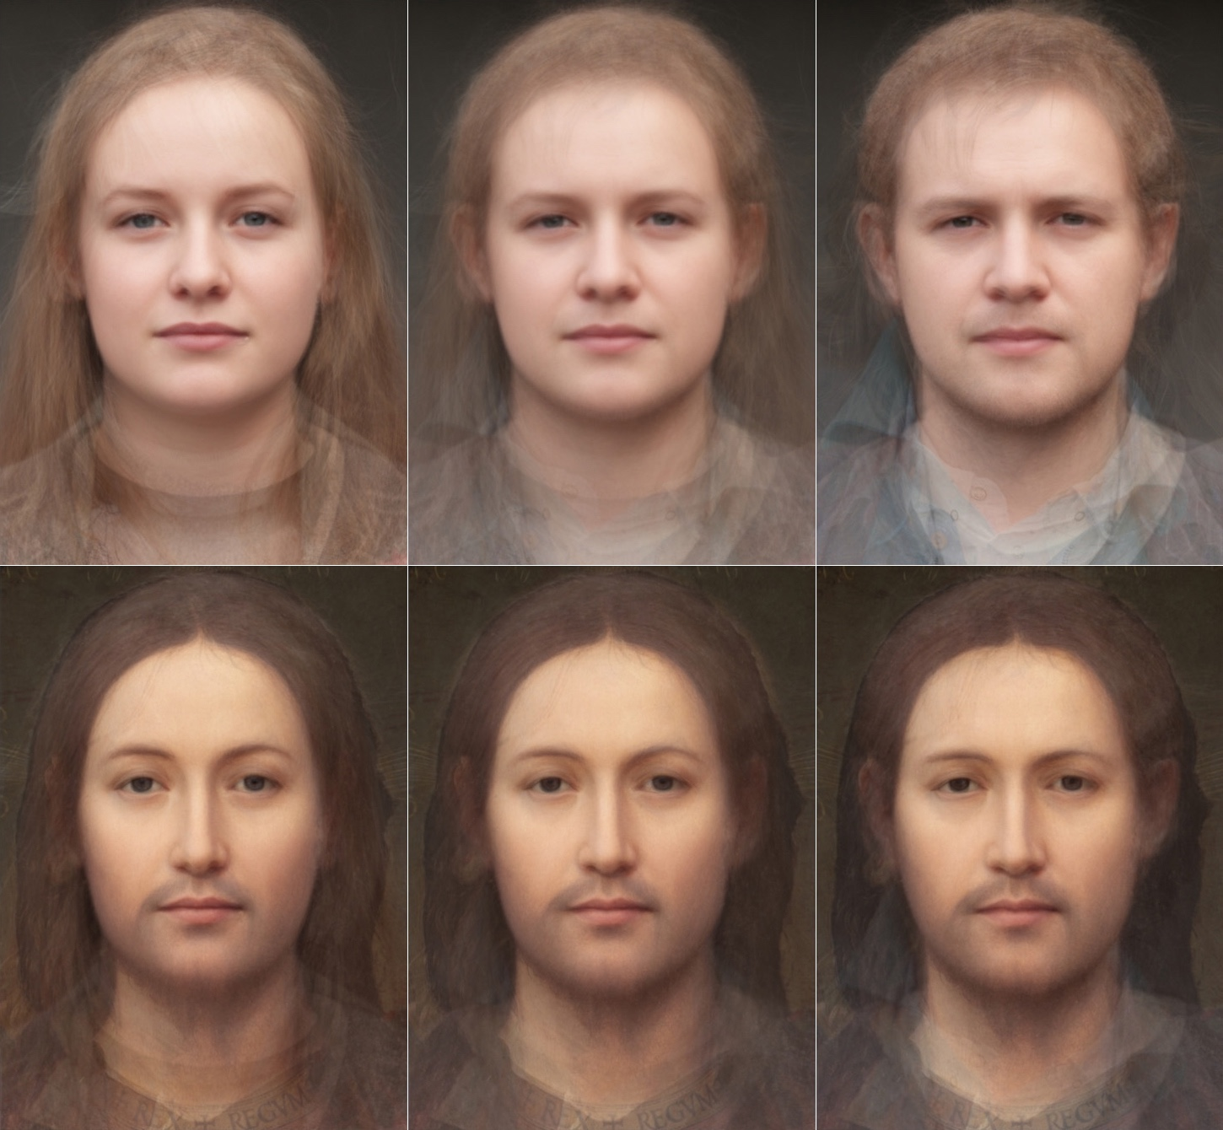
The creation of a prototype
Notes:
The upper row shows the prototypes for Female, Human, and Male. These images are created by morphing all female participants, all participants male and female, and all male participants.
The lower row shows the results of morphing each prototype with the prototype of Christ: A female Christ, a neutral human Christ, and a male Christ.

Slide 23
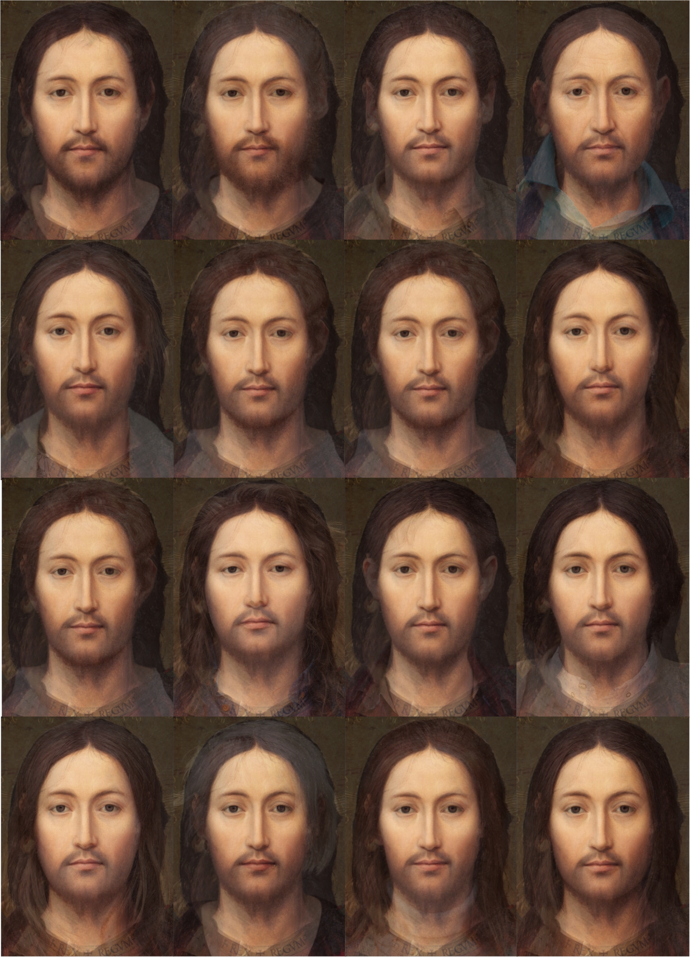
The creation of a prototype
Notes:
These images are the “Personalized Jesus” images. Each portrait is a person morphed with the prototype of Christ in proportion 80/20.
Rows are: Male, Female, Male, Female. As can be seen, it is possible to detect the gender of the person behind each portrait (mainly through facial proportions).
The female images gives a “milder” impression.

Slide 24
Notes:
Even though “Prototype Jesus” (PJ) is part of all individualized personal images it is chosen significantly more often in competition with all the “Personalized Jesuses”.
It’s only competitor for most popular choice is “Prototype Woman” (PW). However, when we selected only instances of SELF against prototypes we did not find any significant difference form this general pattern. SELF did not increase the perceived attractiveness of an image. We may interpret that as “Narcissism is not common” – our perception of apperance is not so different from how others perceive us.
Also note that adding Male to Prototype Jesus (PMX), makes it lose against more Personalized Images, and the same is noted for adding the Human Prototype to Prototype Jesus (PHX).
The effect can be interpreted as diluting female features in Prototype Jesus. We did not see that this effect was related to the gender of the Participant.

Slide 25
Notes:
This graph shows that prototypes in general are significantly faster when the decision is for the prototype.
The exceptions are “Prototype Jesus”, which is harder to decide, as it is part of all personalized images, but nevertheless it is chosen more often
--- and Prototype Woman, who might have slightly more of the features that we think increase attractiveness.

Slide 26
Main conclusions
The findings support our central hypothesis concerning the adaption of the image of Christ towards a cognitively more pleasing image.
  An advantage for female features was detected, supporting earlier results on feminine features in the image of Christ (cf. Folgerø et al. 2016b).
However, we did not find that images containing features of self were judged as more attractive.
  Following DeBruin (2005), we suggest that the results would have been different if we had asked the participants to judge trustworthiness instead of attractiveness.
Notes:
In ongoing data-collection, we note that a majority of our participants now claim, in debriefings, to have recognized themselves in a similar task that includes selecting the face they trust the most.
More research is needed to investigate if trustworthiness is more associated with self-similarity.
Likability is not only attractiveness, but also trustworthiness.

Slide 27
References (see article for full list)
DeBruine, L. 2002. Facial resemblance enhances trust. Proceedings of the Royal Society B: Biological Sciences, 269(1498), 1307-1312.
DeBruine, L. 2005. Trustworthy but not lust-worthy: Context-specific effects of facial resemblance. Proceedings of the Royal Society B: Biological Sciences, 272(1566), 919-922.
Folgerø, P., Hodne, L., Johansson, C., Andresen, A., Sætren, L.C., Specht, K., Skaar, Ø.O. & Reber, R. 2016a. Effects of Facial Symmetry and Gaze Direction on Perception of Social Attributes: A Study in Experimental Art History, Frontiers in Human Neuroscience, 10, September 2016.https://doi.org/10.3389/fnhum.2016.00452
Folgerø, P., Johansson, C. & Andresen, A. 2016b. Transgender Priming in Medieval Europe, XXIV. Conference of the International Association of Empirical Aesthetics, Vienna, Austria. August 29 – September 1. 2016.
Music for inspiration :-D
Thomas di Leva: Everyone is Jesus
https://www.youtube.com/watch?v=GllR1WyDzJc
Depeche Mode: Personal Jesus
https://www.youtube.com/watch?v=u1xrNaTO1bI
A big Thank You to all our participants!

