Slide 1
Teaching Methods Using Problem -Based Learning (PBL ) and Research Methodology for Neuroaesthetics
Oana GEMAN
Ph.D. Associate Professor Bioengineer
Neuroaesthetics Lab
https://neuroaestheticslab.usv.ro/
Stefan cel Mare University of Suceava, Romania
oana.geman@usm.ro

Slide 2
OUTLINE OF THE PRESENTATION
Teaching Solution in Pandemic Era – PBL
Research Process
Research Overview
Research Method
Research Design
Conclusion

Slide 3
1. EDUCATION
Dr. Shoumen Datta:

Slide 4
TO BE A GOOD TEACHER IN PANDEMIC ERA?!... “The influence of teachers extends beyond the classroom, well into the future.” - F. Sionil Jose

Slide 5
What Is PBL?
Problem-Based Learning:
From Ideas to Solutions through Communication

Slide 6
Characteristics Needed in College Graduates
High level of communication skills
Ability to define problems, gather and evaluate information, develop solutions
Team skills -- ability to work with others
Ability to use all of the above to address problems in a complex real- world setting
Quality Assurance in Undergraduate Education (1994) Wingspread Conference, ECS, Boulder, CO.

Slide 7
Recommendations from the Carnegie Foundation
Make research-based learning the standard.
Build inquiry-based learning throughout the four years.
Link communication skills and course work.
Use information technology
effectively.
Cultivate a sense of community.
Boyer Commission, 1998

Slide 8
What Is PBL?
“The principal idea behind PBL is that the starting point for learning should be a problem, a query, or a puzzle that the learner wishes to solve.”
Boud, D. (1985) PBL in perspective. In “PBL in Education for the Professions,”
D. J. Boud (ed); p. 13.

Slide 9
What Is PBL?
“…careful inspection of methods which are permanently successful in formal education…will reveal that they depend for their efficiency upon the fact that they go back to the type of situation which causes reflection out of school in ordinary life. They give pupils something to do, not something to learn; and if the doing is of such a nature as to demand thinking, or the intentional noting of connections; learning naturally results.”
John Dewey (1916)

Slide 10
PBL is…
“…a process of acquiring understanding, knowledge, skills and attitudes in the context of an unfamiliar situation, and applying such learning to that situation.”
- C. E. Engel, University of Newcastle

Slide 11
What are the Common Features of PBL?
Learning is initiated by a problem.
Problems are based on complex, real-world situations.
All information needed to solve problem is not given initially. Students identify, find, and use appropriate resources.
Students work in permanent groups.
Learning is active, integrated, cumulative, and connected.

Slide 12
PBL: The Process
Resolution of Problem; (How did we do?)
Presentation of Problem
Organize ideas and prior knowledge (What do we know?)
Integrate new Information; Refine questions
Next stage of the problem
Pose questions (What do we need to know?)
Reconvene, report on research;
Research questions; summarize;
analyze findings
Assign responsibility for questions; discuss resources

Slide 13
The Problem-Based Learning Cycle
Overview
Assessment
(when desired)
Problem, Project, or Assignment
Mini-lecture
(as needed)
Whole Class Discussion
Group Discussion
Preparation of Group
―Product‖
Research
Group Discussion

Slide 14
A Typical Day in a PBL Course on site…but … we can move on line…

Slide 15
Question for Groups
Reflect on this morning’s experience:
What do instructors do to guide students working on a PBL problem?
Be prepared to report out in 5-10 min.

Slide 16
Factors in Choosing a Model
Class size
Intellectual maturity of students Student motivation
Course learning objectives Instructor’s preferences
Availability of peer facilitators

Slide 17
Common Classroom Models
Medical School or Engineering School
Floating Facilitator
Peer Facilitator
“Hybrid”

Slide 18
Medical School Model
Dedicated faculty tutor
Groups of 8-10
Very student-centered environment
Group discussion is primary class activity
A good choice for
Highly motivated, experienced learners
Small, upper-level seminar classes

Slide 19
Floating Facilitator Model
More structured format: greater degree of instructor input into learning issues and resources
Group size: 4
Instructor rotates through groups: Asks questions, directs discussions, checks understanding
Other class activities:
Groups report out
Whole class discussions
(Mini-)lectures
A good choice for
Less experienced learners
Classes of all sizes

Slide 20
Peer Facilitator Model
Advanced undergraduates serve as facilitators
Help monitor group progress and dynamics
Serve as role models for novice learners
Capstone experience for student facilitators
A good choice for
Classes of all sizes

Slide 21
Dealing with Large Classes
Floating facilitator or peer facilitator models are the most appropriate.
Requires a more teacher-centered, structured format: instructor directs group activities
Group size: 4
Reduce grading burden through group (vs. individual) papers, projects

Slide 22
“Hybrid” PBL
Non-exclusive use of problem-driven learning in a class
May include separate lecture segments or other active-learning components
Floating or peer facilitator models common
Often used as entry point into PBL in course transformation process

Slide 23
Effectiveness of PBL: Research
Ample evidence for the value of active and cooperative learning (Johnson, Johnson and Smith, 1991)
Strict comparisons of PBL and traditional approaches difficult to design (Prideaux, 2000):
Randomization, blinding difficult
Many uncontrollable variables: variants in PBL, resources, motivation
Appropriate outcome measures: content knowledge vs. process skills
Most research studies from medical education

Slide 24
General Trends from Research
Content knowledge comparable to that found in traditional courses (Newman, 2003)
PBL leads to
improvement in student attitude and clinical performance (Vernon and Blake, 1993)
deeper approach to learning (Newble and Clarke, 1986)
better interpersonal skills and attitudes towards patients (Nandi et al., 2000)

Slide 25
The case serves as a stimulus for learning

Slide 27
 | PROBLEM SOLVING | PROBLEM-BASED LEARNING
Educational strategy | Traditional discipline-based | Integrated systems-based
Main characteristics | - The focus is on preparatory learning prior to exposure to the problem. - The staff set the problems (case history problems in a primarily lecture- based format), and students attempt to resolve them using previously taught curricular content. | The problem comes first without advance readings, lectures, or preparation. The problem serves as a stimulus for the need to know. - Based on their own prior knowledge and the identified gaps in that knowledge, students determine the learning issues within their own group. They then identify and use a variety of learning resources to study these issues and return to the group to discuss and share what they have learned.

Slide 28
 | PROBLEM SOLVING | PROBLEM-BASED LEARNING
Role of the teacher | Content expert | Tutor/Facilitator
Learning environment | Passive, teacher-centered | Learning becomes dependent upon the self-directed efforts of the small group. This method creates a more active, student-centered learning environment
Who is responsible for directing the learning activities | Teacher | The student decides what he/she needs to learn

Slide 29
Efficacy and advantages of PBL

Slide 31
PBL: the claims and the evidence

Slide 33
Hybrid curricula
In preclinical phase, PBL can be designed and timetabled so as to complement other teaching methods such as:
Lectures
Practicals, other laboratory work
Computer-assisted learning

Slide 34
Example
While learning about Neuroaesthetic Field in PBL tutorials, students discuss about definitions, generalities, examples.

Slide 35
THE PBL TUTORIAL PROCESS
Key steps in the PBL tutorial process
Case presentation
Identifying key information
Generating and ranking hypotheses
Generating an enquiry strategy
Defining learning objectives
Reporting back
Integrating new knowledge
The PBL process is tightly structured and contains a
number of key steps
The PBL tutorial:
Typically consists of a small number of students (ideally
between 6-10)
Is facilitated by one or more faculty tutors who guide the process without contributing directly to the solution of the problem or being the primary source of information
Meeting two times a week for two or three hours per session
Completing a case in two or three sessions

Slide 37
How does problem-based learning work?
What instructors do:
Develop real-world, complex and open-ended problems such as might be faced in the workplace or daily life.
Act as facilitators, making sure students are staying on track and finding the resources they need.
Raise questions to student groups that deepen the connections they make among concepts.
- Strike a balance between providing direct guidance and encouraging self-directed learning.
What students do:
Address the problem, identifying what they need to learn in order to develop a solution and where to look for appropriate learning resources.
Collaborate to gather resources, share and synthesize their findings, and pose questions to
guide further learning tasks for the group.

Slide 38
Case presentation

Slide 39
How does a case serve as a stimulus for learning?

Slide 40
Example:
PBL tutorial process
1. Case presentation (Medical Example): The tutor provides the group with some introductory clinical information about a hypothetical patient.
Mary Smith, a 28-year-old office worker and part-time swimming instructor, comes to see her GP because of pain in her chest and shortness of breath. This has been a recurring problem in recent months and seems to be gradually worse. On the previous evening, while participating in a swimming gala, she became so short of breath that she found it difficult to walk.

Slide 41
Identifying key information
2.
3.
Generating and ranking hypotheses:
e.g., Infection, cardiac problem, allergy, asthma, broken rib.
Allergy ˃ cardiac problem
4.
Generate an enquiry strategy:
What additional information is required?
e.g., Previous medical problems and relevant drug, family & psychosocial histories, physical exam, lab. tests.

Slide 42
Additional information
Further discussion with her GP reveals that Ms Smith’s chest pain and shortness of breath come on following exercise, particularly in a cold environment. When she becomes particularly short of breath, she starts to wheeze. She sometimes has a dry cough and has never had haemoptysis. There is no recent history of physical trauma and no personal or family history of heart disease. She had eczema in childhood but has never had asthma. She has smoked for the past 5 years and increased her smoking to 40 cigarettes a day since she broke up with her intimate friend 3 months ago. She takes an oral contraceptive pill but no other medication.

Slide 43
New information
Revising their hypotheses
Discard / Re-rank / Other hypotheses
Broken rib
Asthma
Cardiac problem
Anxiety attacks with hyperventilation
Possible thromboembolic disease due to oral contraceptive use

Slide 44
5. Defining learning objectives
Once the students have decided on a preferred hypothesis (e.g., allergy), they must explain the biomedical science mechanisms that link their hypothesis to the presenting problems.
What students know?
What they do not know?
What they need to know?
to further their understanding of the underlying mechanisms, and their ability to solve the clinical problem.
e.g., Students may identify gaps in their knowledge of the mechanics of breathing, anatomy of airways, mechanisms of oxygen delivery to tissues, or mechanisms of pain perception.

Slide 45
5. Defining learning objectives (cont.)
The identification of gaps in knowledge helps students to define their learning objectives and these become the focus of self-directed study in the interval between tutorials.
Learning objectives should be clear and specific and of appropriate scope to be addressed in the time available between tutorials (typically 2-3 days).
At each tutorial, the group might identify three to five major learning objectives and perhaps an equal number of lesser objectives.

Slide 46
5. Defining learning objectives (cont.)
Although the PBL tutorial is student-centered, major learning objectives are identified in advance by the case writers as part of the overall curriculum design. Tutors may need to provide prompts to ensure that major objectives are identified and pursued.
In PBL, as knowledge is acquired in the context of a specific clinical problem (the problem is encountered before the student has the knowledge to understand it), it is likely to be better focused and retained.

Slide 47
6. Reporting back
In the follow-up tutorial, students reconvene to report on their self- directed study and share and integrate new knowledge.
All students should contribute to the report-back and their unique perspectives are incorporated into the process of knowledge building. The exchange and debate of ideas promotes the consolidation and elaboration of new knowledge and understanding

Slide 48
CHECKLIST FOR PROBLEM CONSTRUCTION
Is the content of the problem geared to students' prior knowledge?
Is there a clear connection with one or more of the objectives of the block?
Is the problem sufficiently complex to offer cues for initial discussion and for generating learning issues?
Is the problem structured in such a way that it offers cues for discussion in the group?
Has the problem been formulated clearly and, if possible, does it offer links with professional practice?
Is the problem multidisciplinary and is clear to students?
Does the length of the problem enable inclusion of all the relevant information that is needed for
identifying learning issues and does the problem not contain superfluous irrelevant information?
Is the available time sufficient for studying the learning issues?
Is there sufficient time available for reporting on all the learning issues?
Does the block offer sufficient variety in learning activities, i.e. does it include different types and formats of problems?
Is the number of problems geared to the number of group meetings in the block? Has a schedule been
drawn up that specifies which problems are to be discussed when?
Which problems should be tackled in a specific sequence?

Slide 49
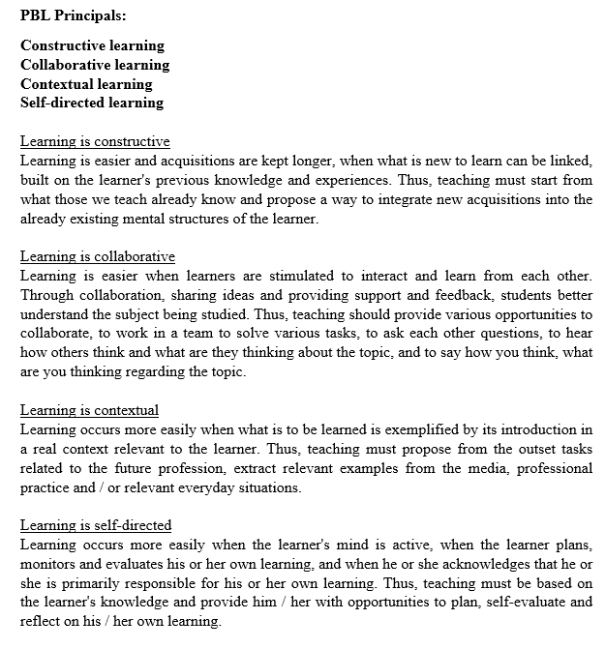

Slide 50
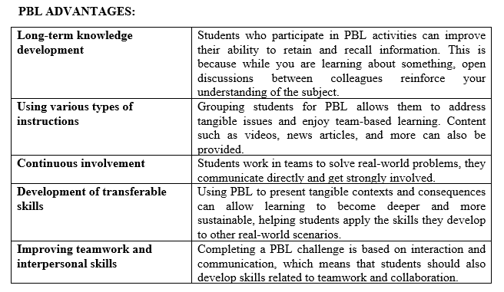

Slide 51
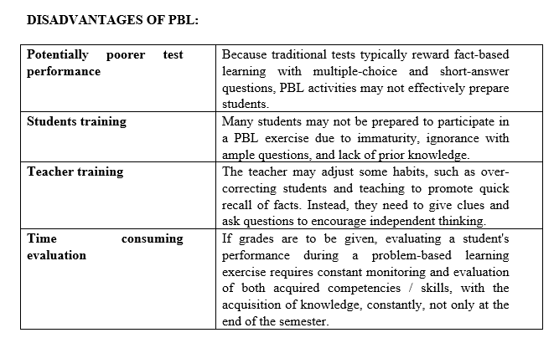

Slide 52
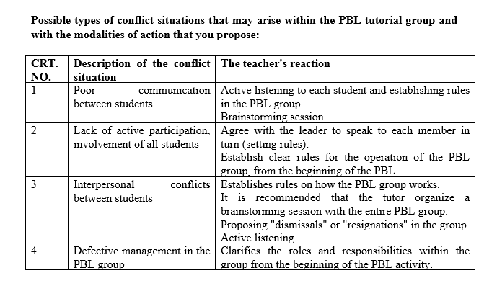

Slide 54
https://ocw.mit.edu/courses/womens-and-gender-studies/wgs-693-gender-race-and-the-complexities-of-science-and-technology-a-problem-based-learning-experiment-spring-2009/problem-based-learning/

Slide 55
https://www.cumbria.ac.uk/research/enterprise/tean/teachers-and-educators-storehouse/archive/problem-based-learning/

Slide 57
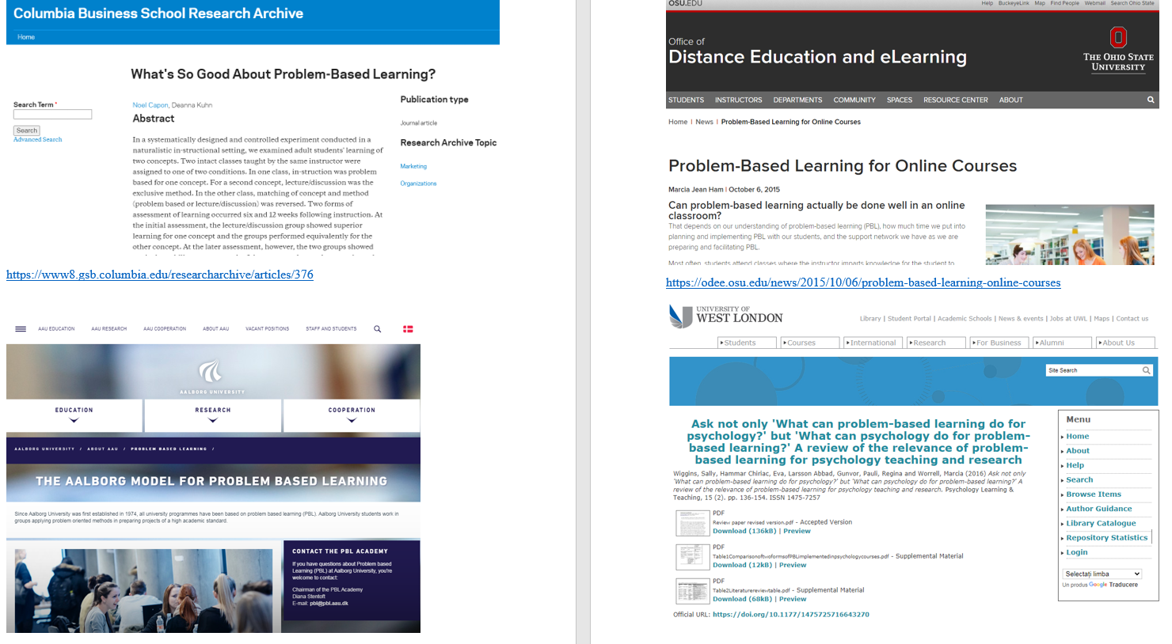

Slide 59
PBL & NEUROAESTHETICS - ONE EXAMPLE:

Slide 61
Constructive alignment of assessment with learning objectives and learning activities (Biggs and Tang, 2011) starts from the fact that a teaching process is considered effective, if we develop the design of the activity combining in a constructivist way the following elements: goals, activities learning and assessment tasks (Figure 1).
Constructive alignment is a way of designing a course or way of learning based on what learners should know and be able to demonstrate at the end of the course. Learning objectives, assessment methods, and learning / learning facilitation activities are intentionally “aligned” so that learning outcomes are as good as possible (Blumberg, 2009).
Our education is focused on skills, the relevance is as follows: since we aim to develop skills (general, specific) in students, "Assessment is an organic component of the learning process.".
We can explain the phrase in quotation marks from the previous paragraph with Biggs' help: learning objectives, learning activities and assessment must be "aligned", i.e. assessment must be incorporated into the learning process. I need to establish, as a trainer, how I will assess learning and include those opportunities to demonstrate the competence pursued in the design of the learning process. In other words, learning tasks and assessment tasks are basically one and the same thing. Implication: the paradigm of the three distinct moments (design - teaching - evaluation) must be taken seriously. While "teaching", in fact while facilitating the learning process, I have to evaluate. Moreover, before I think about how I will facilitate learning, I have to decide what and how I will evaluate, because - since assessment tasks are learning tasks - it makes sense that I have to design these tasks first.

Slide 62
In general, a checklist would include the following questions:
What are the objectives of the course? (What will students know at the end of the course and be able to apply in practice?)
What is the form of organizing the course? (lecture, discussions, teamwork)
What is the ultimate goal of the activities? (what are the skills and attitudes developed?)
What are the preconditions and conditions for promoting the course?
What is the purpose of the test? (understanding, capacity for synthesis, application of knowledge in a new context)
What are the assessment methods meant to help the student learn?
What are the recommended bibliographic references for students? (the recommended bibliography should be specified for each chapter).

Slide 63
Specific assessment methods to test the acquisition of both knowledge and skills and abilities
This will include the list of questions that students will have to answer, the structure of the presentation or project they are going to support or the list of requirements that the practical work must satisfy if necessary. Depending on the specificity of each course, this part can include any type of assessment that the teacher considers appropriate for testing the acquisitions accumulated during the course.
The products of the problem-based learning process are:
1. Report;
2. Presentation;
3. Annexes of each report (minutes, concept maps, summaries, reported projects).
The evaluation should be divided into two directions:
1. product component and
2. the component of the process.

Slide 64
The study group will submit one of the following documents at the end of each project: a poster, report, oral presentation, a web page, a drawing or the construction of a device. The specific format will be identified in the initial phase.
Each individual in the group will be evaluated according to how well they do in the following directions:
- Analysis of the problem;
- Innovation of possible solutions;
- Critical evaluation of the group's suggestions;
- Demonstration of both previous and newly acquired knowledge by participating in the case study;
- using practical skills in solving the problem.

Slide 65
Their role as a team member will also be assessed, including how well they have fulfilled their role of:
- leader of the discussion;
- scribe;
- time administrator;
- member of the group.
One of the weaknesses of the PBL system is the lack of a formal evaluation (Reis & Renzulli, 1991) because it is often missing or not aligned with the objectives of the PBL. Although there is much written work on student assessment, these assessment methods are not often applied in PBL groups (Reis & Renzulli, 1991; Treffinger, 1989; Westberg, 1991).

Slide 66
2. RESEARCH METHODOLOGY

Slide 67
OUTLINE OF THE PRESENTATION
Research Process
Research Overview
Research Method
Research Design
Conclusion

Slide 68
The Research Process
OBSERVATION
Broad Area of Research Interest
PROBLEM DEFINITION
Research problem
delineated
THEORETICAL FRAMEWORK
Variables clearly
identified
GENERATION OF HYPOTHESES
PRELIMINARY DATA GATHERING
Interviews & Literature
review
DEDUCTION
Hypotheses substantiated?
Research Questions answered?
DATA COLLECTION, ANALYSIS & INTERPRETATION

Slide 69
RESEARCH PROCES

Slide 70
RESEARCH OVERVIEW
INTRODUCTION
Introducing of research problem
Introduction of objectives and how objective will be achieved
LITERATURE REVIEW
Review of previous work relating to research problem (define, explain, justify)
Review of previous work relating to methodology
Review of previous work relating to results (particular reliability, etc.)

Slide 71
RESEARCH OVERVIEW
METHOD
Explanation of how data was collected/generated
Explanation of how data was analyzed
Explanation of methodological problems and their solutions or effects
RESULTS AND FINDINGS
Presentation of results
Interpretation of results

Slide 72
OVERVIEW
DISCUSSION AND CONCLUSION
Recapitulation of the findings (without figures)
Discussion of result
(e.g. comparison with results in previous research, effect of method used on the data obtained)
Has the research problem been solved?
To what extent has the objective being achieved?
What has been learnt from the results?
How can this knowledge be used?
What are the shortcomings of the research or research methodology?

Slide 73
Styles of Research
Applied Research
Pure Research/Basic Research
Business Research
■

Slide 74
EXAMPLES OF DIFFERENT TYPES OF RESEARCH
Applied Research
Case study
Comparison
Basic/Fundamental Research
Correlation-prediction
Experiment
Survey-questionnaire
Theory construction
Trend analysis
Business Research
Analysis
Evaluation
Design-demonstration
Status

Slide 75
WHAT IS BASIC RESEARCH
The goal is to produce new knowledge, which takes three main forms:
Exploratory research, which structures and identifies new problems
Constructive research, which develops solutions to a problem
Empirical research, which tests the feasibility of a solution using empirical evidence
Research can also fall into two distinct types:
Primary research
Secondary research.
Research is often conducted using the hourglass model.[1]

Slide 76
RESEARCH METHOD
The method section answers two main questions
How was the data collected or generated?
How was it analyzed?
“ It shows your reader how you obtained your results”

Slide 77
METHOD
Why do you need to explain how you obtained your results???
Method affects results
Helps the reader evaluate the validity and reliability of your results and
conclusion you draw from them

Slide 78
METHOD
Your methodology should make clear the reasons why you choose a particular method or procedure.
The data was collected or generated in a way consistent with accepted practice in the field of study
The research method must be appropriate to the objectives of the study
The methodology should also discuss the problems that were anticipated and explain steps taken to prevent them from occurring

Slide 79
RESEARCH DESIGN
Design research investigates the process of designing in all its many fields.
It is thus related to Design methods in general or for particular disciplines.
A primary interpretation of design research is that it is concerned with undertaking research into the design process.
Secondary interpretations would refer to undertaking research within the process of design. The overall intention is to better understand and to improve the design process.

Slide 80
RESEARCH DESIGN

Slide 81
QUATITATIVE
Data in numbers
it investigates the why and how of decision making, as compared to what, where, and when of quantitative
research.
Quantitative research is the systematic scientific investigation of properties and phenomena and their relationships.
The objective of quantitative research is to develop and employ mathematical models, theories and/or
hypotheses pertaining to natural phenomena.
The process of measurement is central to quantitative research because it provides the fundamental connection between empirical observation and mathematical expression of quantitative relationships.
Quantitative research is widely used in both the natural sciences and social sciences, from physics and biology to sociology and journalism. It is also used as a way to research different aspects of education. The term quantitative research is most often used in the social sciences in contrast to qualitative research.

Slide 82
QUALITATIVE
Data in words
It involves an in-depth understanding of human behavior and the reasons that govern human
behavior
ualitative research relies on reasons behind various aspects of behavior. Simply put, it investigates the why and how of decision making
the need is for smaller but focused samples rather than large random samples, which qualitative research categorizes data into patterns as the primary basis for organizing and reporting results.
Qualitative researchers typically rely on four methods for gathering information: (1) participation in the setting, (2) direct observation, (3) in depth interviews, and (4) analysis of documents and materials

Slide 83
MULTIMETHOD
Data in both forms

Slide 84
WHATS READERS WANT TO KNOW ABOUT YOUR RESEARCH DESIGN
Purpose of the study
Descriptive
Hypothesis-testing
Case study
Types of Investigation
Clarification
Correlational
Experimental
Extent of researcher interference
Minimal interference
Manipulation
Unit of analysis
Population to be studied
Study setting
Contrived – artificial/lab setting
Non-contrived – natural environment
Time horizon
Cross-sectional
Longitudinal

Slide 85
RESEARCH DESIGN MODEL

Slide 86
CONCLUSION
WHAT IS A GOOD METHODOLOOGY SECTION
Bear in mind the purpose of the method section.
Keep notes of what you did, why you did it, and what happened. Some researchers keep research diaries so that they have a record of the methods they used. Make sure you develop some way of recording your work, and that you then carefully select which material to include in your final methodology section.
Remember who your audience will be, and be careful not to include unnecessary details.
.Avoid using "I" to write about what you did. Do not use "we" unless you really were working with one or more other researchers. One way to avoid this problem is to use passive voice.Verb tenses - be consistent, and choose the correct one!

Slide 87
Exploratory research
is a type of research conducted because a problem has not been clearly defined.
helps determine the best research design, data collection method and selection of subjects.
Given its fundamental nature, it’s often concludes that a perceived problem does not actually exist.
back

Slide 88
Constructive Research
Constructive research
is perhaps the most common computer science research method.
This type of approach demands a form of validation that doesn’t need to be quite as empirically based as in other types of research like exploratory research.
the conclusions have to be objectively argued and defined.
This may involve evaluating the ―construct‖ being developed analytically against
some predefined criteria or performing some benchmark tests with the prototype.
back

Slide 89
Empirical Research
Empirical research
is any research that bases its findings on direct or indirect observation as its test of reality.
Such research may also be conducted according to hypothetico-deductive procedures,
such as those developed from the work of R. A. Fisher.
The researcher attempts to describe accurately the interaction between the instrument (or the human senses) and the entity being observed.
If instrumentation is involved, the researcher is expected to calibrate her/his instrument by applying it to known standard objects and documenting the results before applying it to unknown objects.
back

Slide 90
Primary Research
Primary Research
Primary research (also called field research) involves the collection of data that don't already exist.
Methods of collection primary data
Observation: Looking at and recording what people do and how they behave. Today, store
cameras can be used to observe consumer behaviour
Experiments: Market researchers can use experimental techniques. e.g. test marketing, blind taste tests
Surveys: Involves asking questionnaires to respondents
Consumer panels: Select a group of consumers that the company regularly surveys to identify
changing attitudes
back

Slide 91
Secondary Research
Secondary research (also known as desk research)
involves the summary, collation and/or synthesis of existing research rather than primary research, where data are collected from, for example, research subjects or experiments.
The term is widely used in market research and in medical research.
The principle methodology in medical secondary research is the systematic review, commonly using meta-analytic statistical techniques, although other methods of synthesis, like realist reviews and meta-narrative[1] reviews, have been developed in recent years.
back

Slide 92
DESCRIPTIVE DESIGN
Survey –
applies to any study in which data or responses (be they quant/qual/both) are
recorded via any form of what we think of as "survey instrumentation."
They can take many forms:
Check-off items (e.g., gender, position);
Fill-in-the-blank items;
Likert-type scales (e.g., on a 5-point scale, say, from "strongly disagree" to "strongly
agree,"
Open-ended fill-in items
Observational
instead of administering a survey instrument, the researcher collects data by
observing/tallying/recording the occurrence or incidence of some outcome

Slide 93
HYPOTESIS TESTING
Explain the nature of relationships
Establish differences among groups or the interdependence of two or more factor in a situation
Explain the variance in the dependent variable or to predict organizational outcome.

Slide 94
CASE STUDY
Gathers in-depth information on a single entity
Problem solving techniques
Involve contextual analyses of similar situation in other organization
back

Slide 95
Types of Investigation
Clarification
Clear understanding of the concept
Related to exploratory and descriptive study
Correlational
At least two concept or variables move simultaneously
Causal relationship/experimental/group comparison
One concept or variables causes a movement in another concept or variables
True experiment vs quasi-experiment

Slide 96
True experiment
BY:
DR. NIK MAHERAN NIK MUHAMMAD UiTM KELANTAN

Slide 97
Quasi Experiment
back
BY:
DR. NIK MAHERAN NIK MUHAMMAD UiTM KELANTAN

Slide 98
UNIT OF ANALYSIS
The unit of analysis is the major entity that is being analyzed in the study.
It is the 'what' or 'whom' that is being studied.
In social science research, the most typical units of analysis are individual people.
Other units of analysis can be groups, social organizations and social artifacts, event, dyad
back

Slide 99
EXAMPLES
https://clarivate.com/webofsciencegroup/article/literature- review-definitive- guide/?campaignname=Essential_guide_to_literature_review s_SAR_Global_2020&campaignid=7014N000000D1Z8&utm_ campaign=Essential_guide_to_literature_reviews_SAR_Glob al_2020_Ad_4&utm_source=facebook&utm_medium=paid

Slide 101
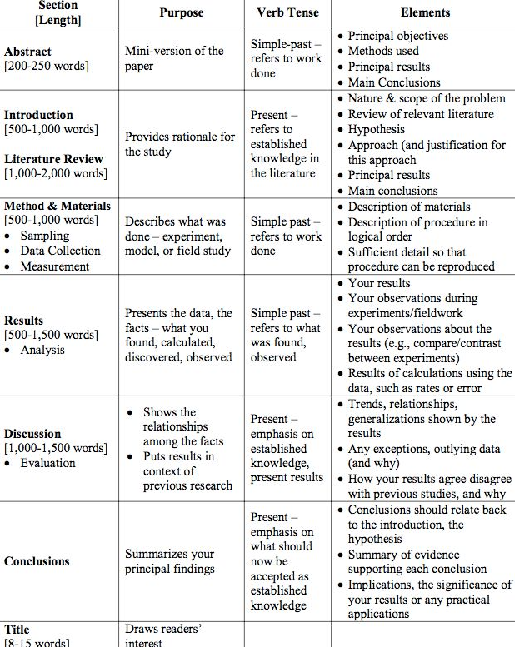

Slide 102
Best practice tips to write a narrative literature review:
Don’t miss a paper: tips for a thorough topic search
Identify key papers (and know how to use them)
Tips for working with co-authors
Find the right journal for your literature review using actual data
Discover literature review examples and templates
We’ll also provide an overview of all the products helpful for your next narrative review, including the
Web of Science, EndNote™ and Journal Citation Reports™.
Keep reading to learn more—and don’t forget to register for our webinar for even more tips when you next write a literature review.

Slide 103
Stay Connected
Want to learn more? Register for our webinar for more tips to write a narrative literature review. You can also read the related blog posts in our Research Smarter series, including finding relevant papers, tips to improve the writing process, and picking the right journal for publication.
And finally, subscribe to receive our latest news, resources and events to help make your research journey a smart one.
Subscribe to receive regular updates on how to research smarter

Slide 104
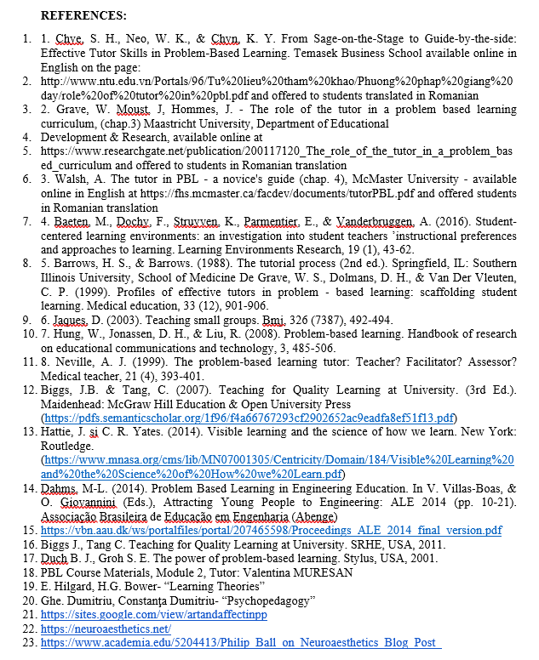

Slide 105
